Slide 1

Blended Learning International Train the Train (BLITT)
Blended Technologies 1
Damian Gordon
Lecturer in Computer Science
To Design, Develop, and Evaluate Quality Blended Learning

Slide 2
Top 200 Tools for Learning
For several years Jane Hart at the Centre for Learning & Performance Technologies has been surveying educationalists to see what are the most commonly used tools.
She publishes the Top 200 Tools for Learning each year.
To Design, Develop, and Evaluate Quality Blended Learning

Slide 3
Top 200 Tools for Learning
The complete list of tools are here:
https://www.toptools4learning.com/home/
To Design, Develop, and Evaluate Quality Blended Learning

Slide 4
Top 200 Tools for Learning
For 2020 here are some of the tools:
To Design, Develop, and Evaluate Quality Blended Learning

Slide 5
Top 200 Tools for Learning
(=) YouTube
(+3) PowerPoint
(=) Google Search
(=) Microsoft Teams
(-3) Zoom
(=) Google Docs
(=) LinkedIn
(+4) Word
(+4) Canva
(-1) Wikipedia
To Design, Develop, and Evaluate Quality Blended Learning

Slide 6
Top 200 Tools for Learning
(=) Slack
(+3) Excel
(-5) Twitter
(+7) WordPress
(+4) Articluate
(+2) Kahoot
(+3) Mentimeter
(+7) Instagram
(-5) Facebook
(+19) Vimeo
To Design, Develop, and Evaluate Quality Blended Learning

Slide 7


Slide 8
Blended Learning International Train the Train (BLITT)
Blended Technologies 2
Damian Gordon
Lecturer in Computer Science
To Design, Develop, and Evaluate Quality Blended Learning

Slide 9
Blended Technologies
This week, we look at some fun simple tools to play around, and create buttons and banners. So, we’ll look at the following:
  Colour Search: TinEye Multicolr
  Colour Extraction: TinEye Color
  Buttons & Banners: Da Button Factory
To Design, Develop, and Evaluate Quality Blended Learning

Slide 10
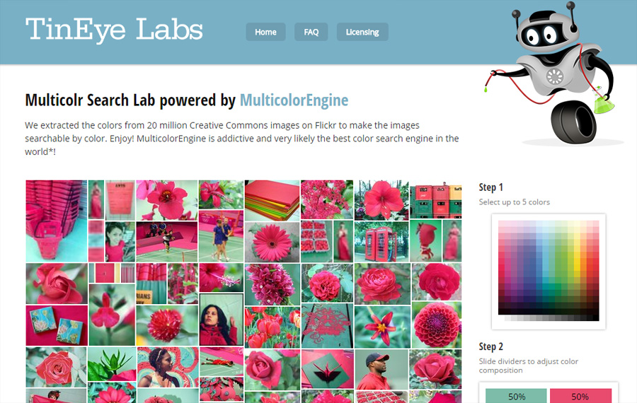
TinEye Multicolr
Colour Search
https://labs.tineye.com/multicolr/
Let’s us search for images by colour(s)
To Design, Develop, and Evaluate Quality Blended Learning

Slide 11
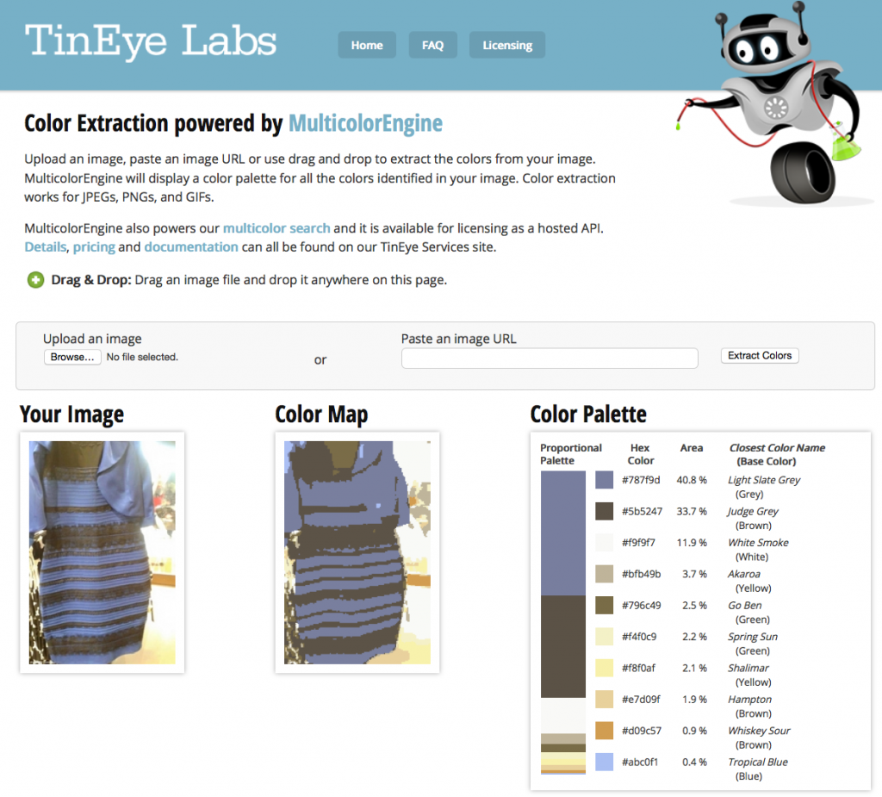
TinEye Color
Colour Extraction
https://labs.tineye.com/color/
Let’s us figure out what colours are in an image
To Design, Develop, and Evaluate Quality Blended Learning

Slide 12
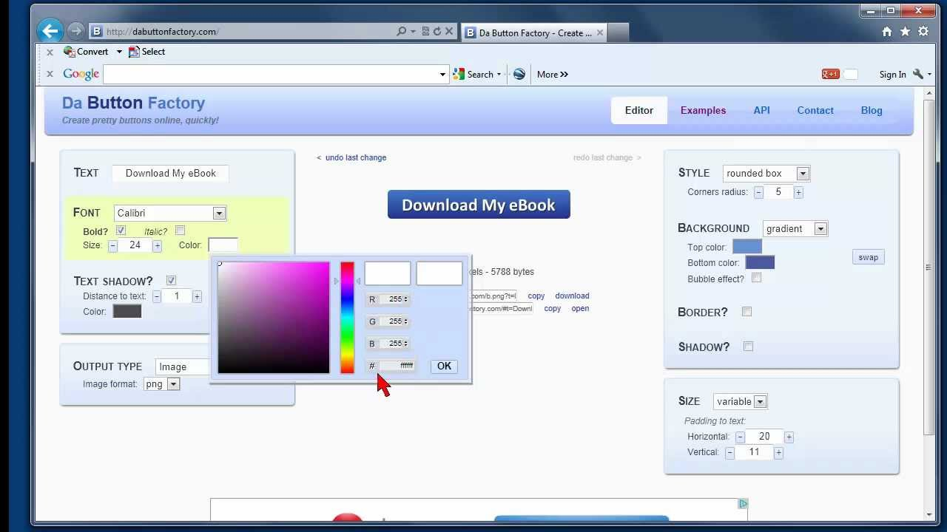
Da Button Factory
Creating Buttons and Banners
https://www.clickminded.com/button-generator/
Helps you create buttons and banners
To Design, Develop, and Evaluate Quality Blended Learning

