Slide 1
Blended Learning International Train the Trainer
Project number 2021-1-SI01-KA220-ADU-000037772

Slide 2
Adult education and training centre
ADULT EDUCATION AT LOCAL LEVEL
COORDINATE AND IMPLEMENT NATIONAL/INTERNATIONAL PROJECTS
CONSULTING AND SUPPORT TO PUBLIC BODIES,
SMES AND ORGANISATIONS AND NETWORKS

Slide 3
On national level
ADULT EDUCATION
INFORMATION TECHNOLOGIES (ICT) & SMART CITIES
CULTURE, TOURISM & HERITAGE
INTERNATIONALIZATION
OUR MAIN FIELDS OF WORK

Slide 4
ADULT EDUCATION: OUR LOCAL TRAINING CENTER
Languages, ICT, support in formal education, exam preparation…
Non-formal activities & workshops
Target groups: students, educators, businesses and public administration

Slide 5
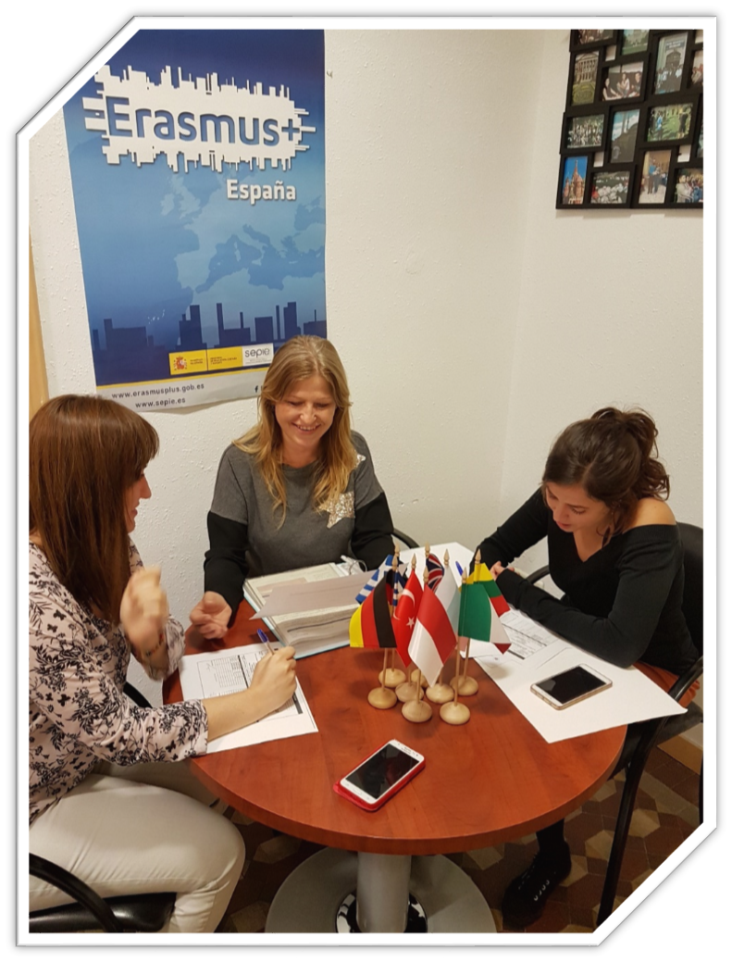
ON INTERNATIONAL LEVEL
European Projects development/management
Design and creation of educational content
Online learning platforms
Train groups of educators
Partners: communities, associations and educational institutions concerned to modernize its learning systems

Slide 6
SOME OF OUR TRAININGS
Make it SMART: how to embed a SMART approach in your Educational Programs
Digital Tools for Adult Learners: how to integrate Digital Tools in Adult Education
Fit for Blended Learning: Introductory Course
Open Your School to Europe: how to make your school more international

Slide 7
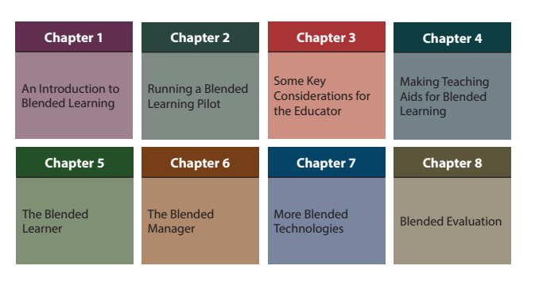
Blended Learning: Introduction for Adult Educators
Practical Suggestions for Combining
e-Learning with Classroom Activities
Erasmus+ Project-No. 2017-1-SI01-KA204-035545

Slide 8
Case Study
Name / Position
Time / chronological information
Place / geographical location
People / individuals involved
Ethics of Case

Slide 9
Case Study
Evidence (Sources of Information the students can investigate)
Situation before intervention (Challenges, issues)
The Intervention (Technology, Education, Organizations, Processes and Policies)
After the intervention (Outcomes)
Issues Raised
Key issues of the case (Good and Bad)
Complexity of the case
Confirming and Disconfirming evidence

Slide 10
Thank you
for your attention
INFO@DOMSPAIN.EU
WWW.DOMSPAIN.EU

