Slide 1
Blended Learning International Train the Train (BLITT)
Blended Technologies 2
Damian Gordon
Lecturer in Computer Science
To Design, Develop, and Evaluate Quality Blended Learning

Slide 2
Blended Technologies
This week, we look at some fun simple tools to play around, and create buttons and banners. So, we’ll look at the following:
Colour Search: TinEye Multicolr
Colour Extraction: TinEye Color
Buttons & Banners: Da Button Factory
To Design, Develop, and Evaluate Quality Blended Learning

Slide 3
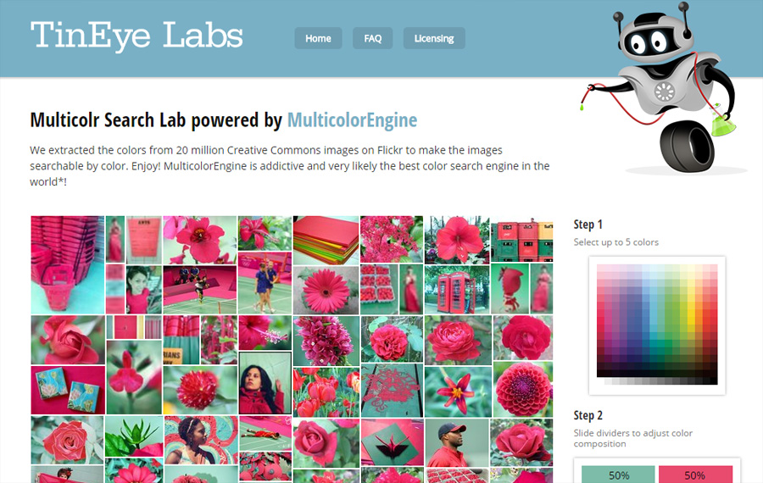
TinEye Multicolr
Colour Search
https://labs.tineye.com/multicolr/
Let’s us search for images by colour(s)
To Design, Develop, and Evaluate Quality Blended Learning

Slide 4
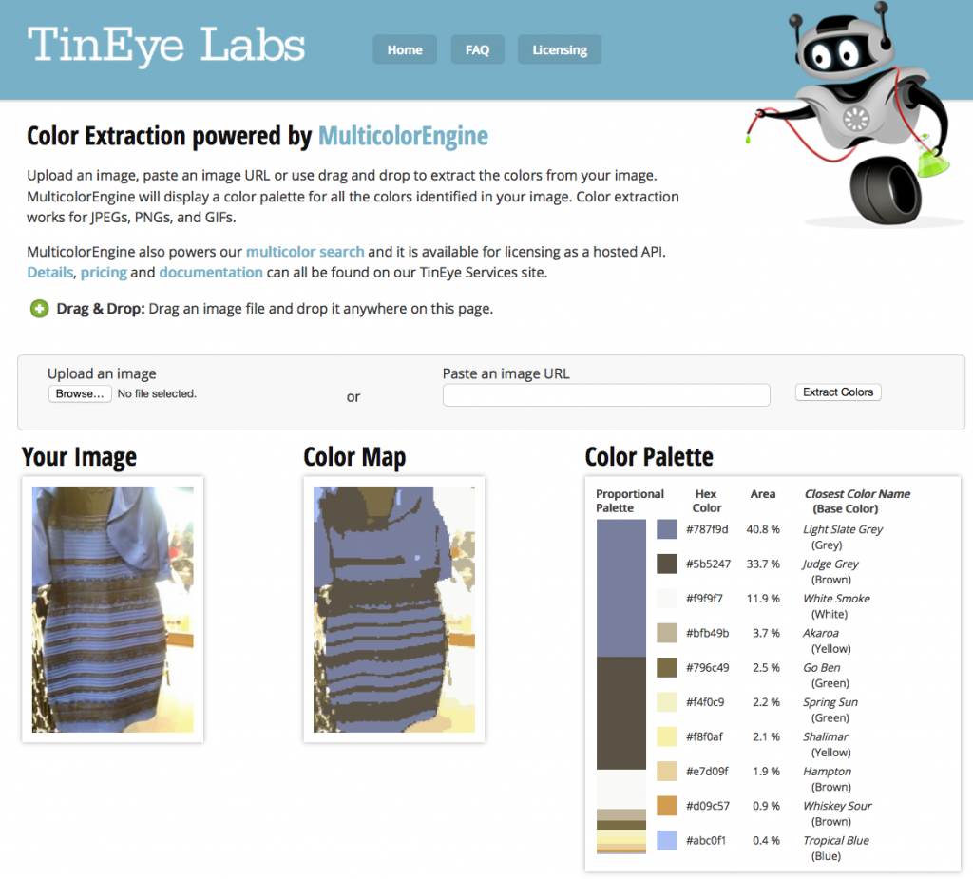
TinEye Color
Colour Extraction
https://labs.tineye.com/color/
Let’s us figure out what colours are in an image
To Design, Develop, and Evaluate Quality Blended Learning

Slide 5
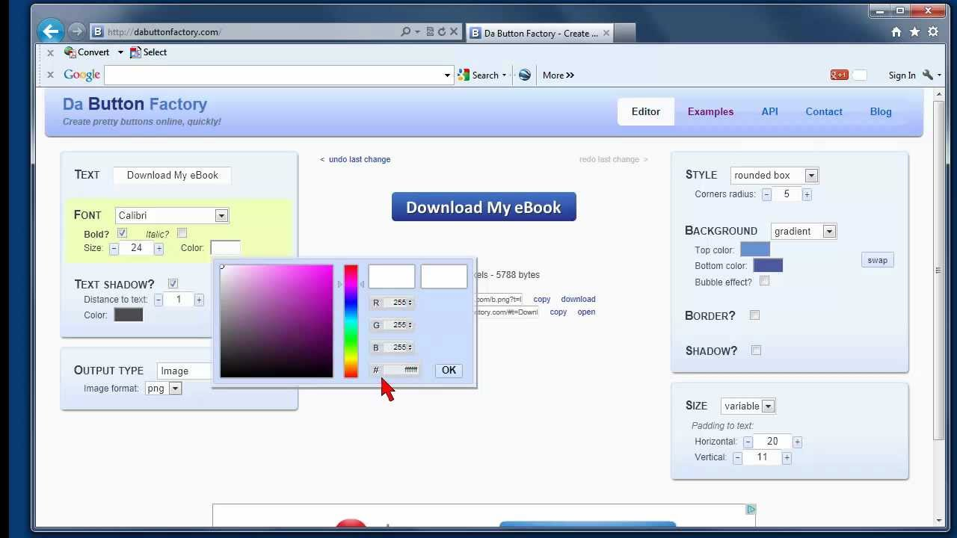
Da Button Factory
Creating Buttons and Banners
https://www.clickminded.com/button-generator/
Helps you create buttons and banners
To Design, Develop, and Evaluate Quality Blended Learning

