Slide 1

Blended Learning International Train the Train (BLITT)
Introduction to Blended Learning
Damian Gordon
Lecturer in Computer Science
To Design, Develop, and Evaluate Quality Blended Learning

Slide 2

B.L.I.T.T.
B.L.I.T.T. = Blended Learning
International Train the Trainer
Who’s presenting?
To Design, Develop, and Evaluate Quality Blended Learning

Slide 3





B.L.I.T.T. Partners
UPI - ljudska univerza Zalec, Slovenia (lead)
Technological University Dublin, Ireland
DomSpain Consulting SL, Spain
A & A Emphasys Interactive Solutions Ltd, Cyprus
IDEC, Greece
Who’s presenting?
To Design, Develop, and Evaluate Quality Blended Learning

Slide 4
B.L.I.T.T. Aims
To train adult educators to become blended learning champions and to be able to train and motivate other teachers for the use of blended learning,
To develop training tools for adult educators: blended learning cases studies and Train the Trainer Course,
To enhance adult educators' blended learning skills,
To increase the capacity of adult education organisations in blended learning offer
To enhance training offers in the adult education sector in the field of innovative teaching methodologies​
Who’s presenting?
To Design, Develop, and Evaluate Quality Blended Learning

Slide 5
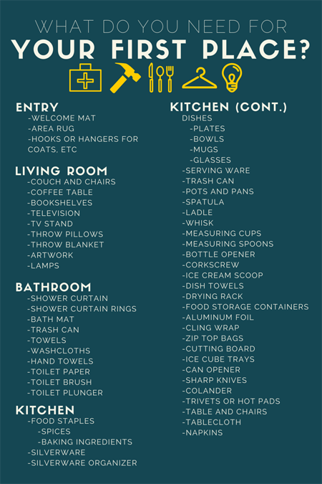
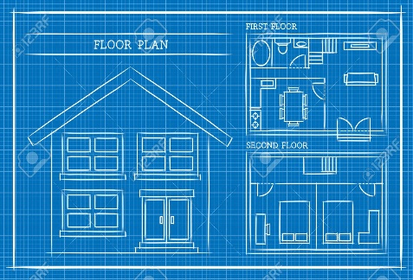
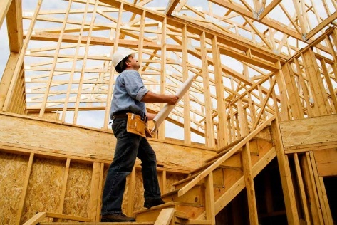
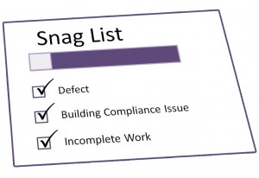
Building a House
Steps in building a house:
Activity | Requirements | Design | Development | Test
Building a house
To Design, Develop, and Evaluate Quality Blended Learning

Slide 6
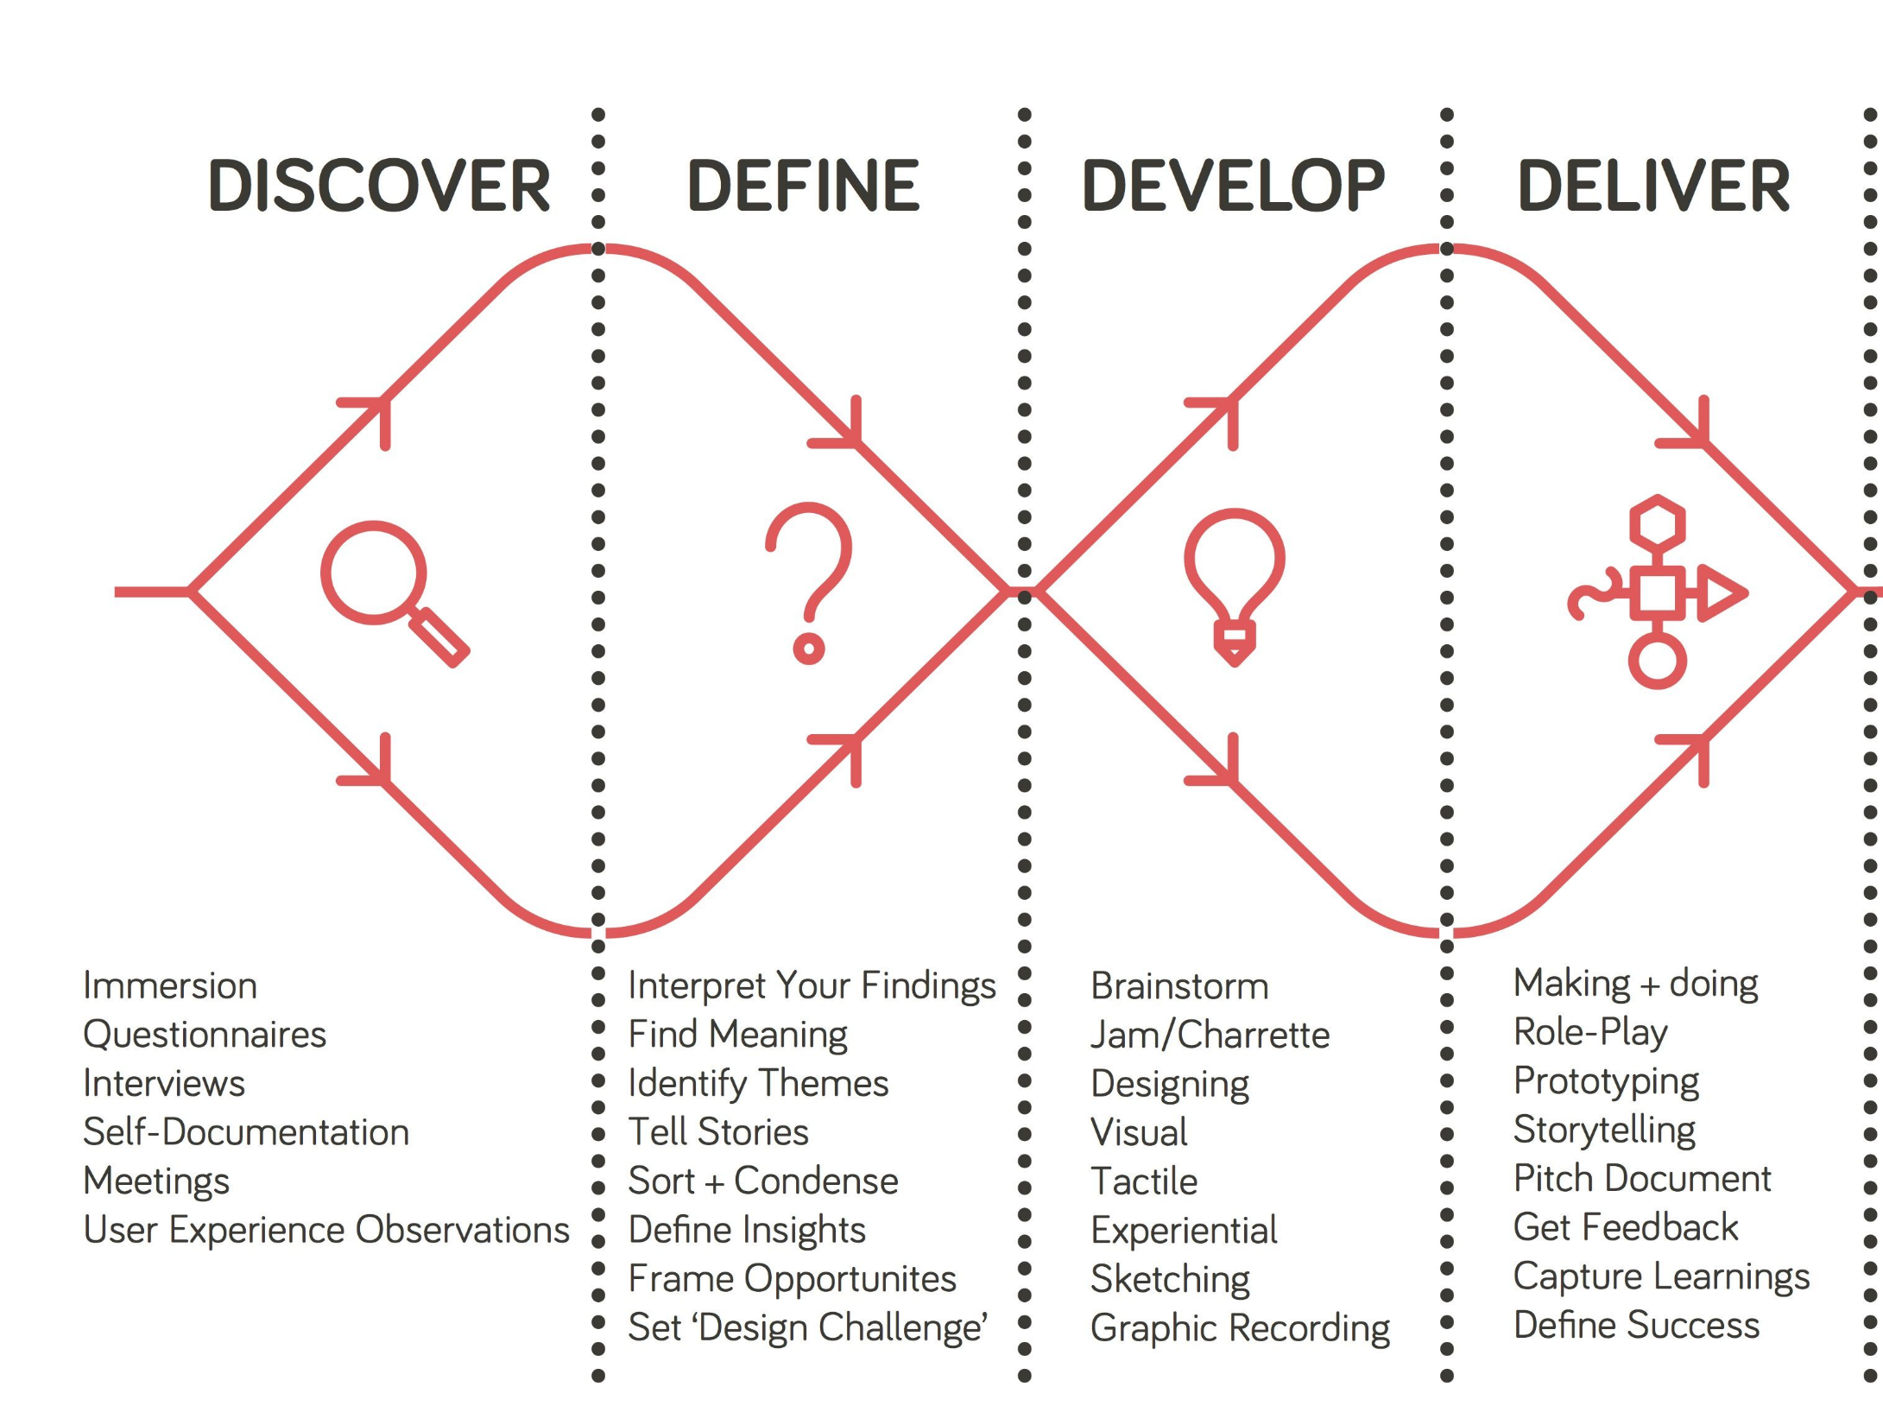
Double
Diamond
Design
Process

Slide 7
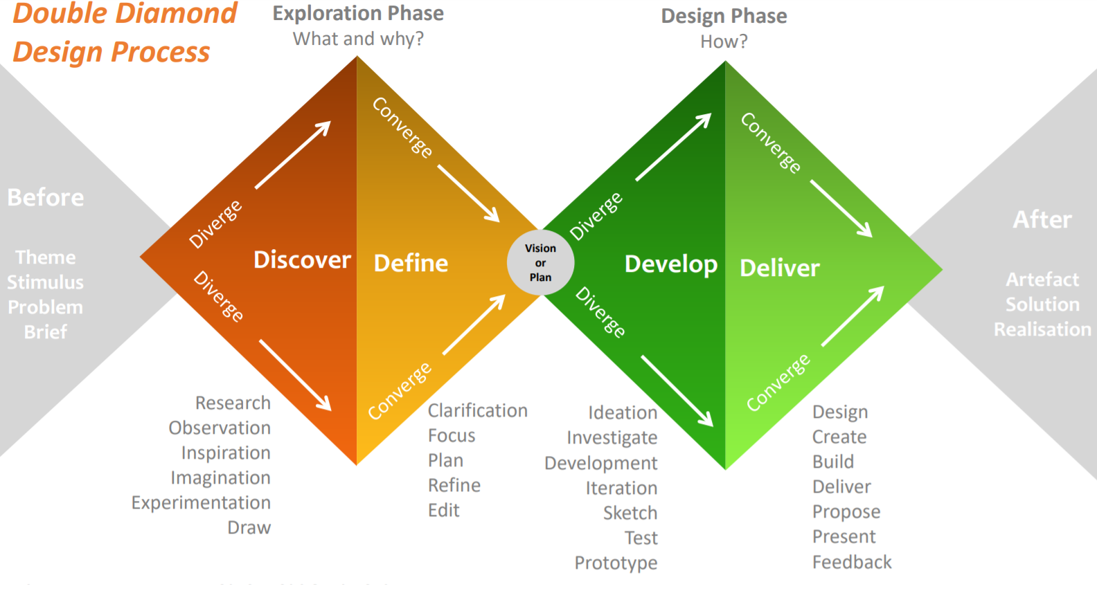
Double Diamond Design Process
To Design, Develop, and Evaluate Quality Blended Learning

Slide 8
What is Blended Learning?
Blended learning, sometimes known as hybrid learning, is a teaching and learning model that has a face-to-face class or tutorial component combined with an e-learning component.
To Design, Develop, and Evaluate Quality Blended Learning

Slide 9
What is Blended Learning?
Traditional
e-Learning
To Design, Develop, and Evaluate Quality Blended Learning

Slide 10
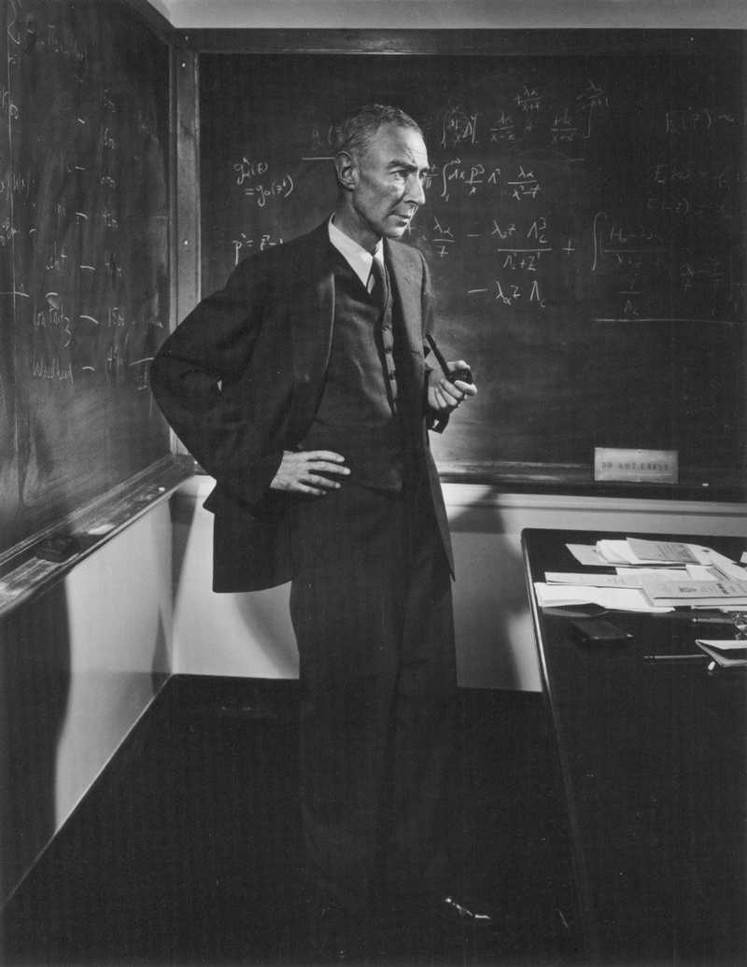
What is Blended Learning?
Conversation
Interaction
Collaboration
Motivation
Traditional
To Design, Develop, and Evaluate Quality Blended Learning

Slide 11

What is Blended Learning?
Mobility
Tracking
Globalisation
Flexibility
e-Learning
To Design, Develop, and Evaluate Quality Blended Learning

Slide 12
What is Blended Learning?
Conversation
Interaction
Collaboration
Motivation
Mobility
Tracking
Globalisation
Flexibility
Traditional
e-Learning
Blended Learning
To Design, Develop, and Evaluate Quality Blended Learning

Slide 13
What is Blended Learning?
Classroom
e-Learning
Classroom
e-Learning
Classroom
e-Learning
To Design, Develop, and Evaluate Quality Blended Learning

Slide 14
What is Blended Learning?
Classroom
e-Learning
Classroom
e-Learning
Classroom
e-Learning
25%
25%
25%
25%
To Design, Develop, and Evaluate Quality Blended Learning

Slide 15
5
Blended Learning
Allen, Seaman, & Garrett (2007)
% e-Learning | % Classroom | Type of Course
0% | 100% | Classroom Learning
1-29% | 77-99% | Web-Facilitated Classroom
30-79% | 21-70% | BLENDED LEARNING
80-100% | 0-20% | Online Teaching
Who’s presenting?
To Design, Develop, and Evaluate Quality Blended Learning

Slide 16

5
Blended Learning
Who’s presenting?
Who’s presenting?
To Design, Develop, and Evaluate Quality Blended Learning

Slide 17
Mixed Mode Learning
Blended
Learning
Hybrid
Learning
Synonyms
Multi-method Learning
Integrated
Learning
Flexible Learning
To Design, Develop, and Evaluate Quality Blended Learning

Slide 18
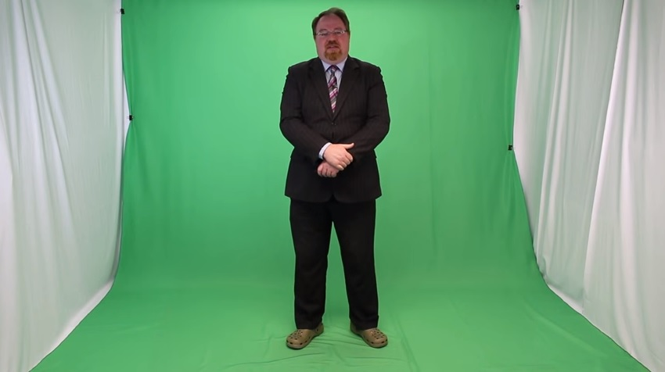

Slide 19
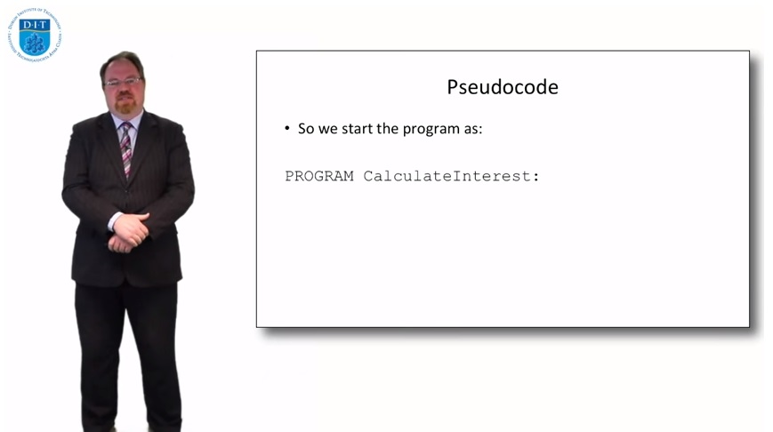

Slide 20


Slide 21
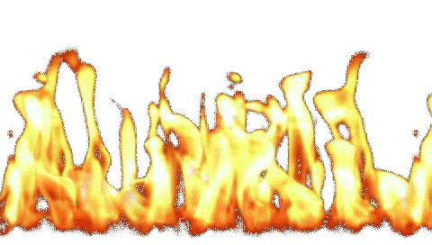

Slide 22


Slide 24
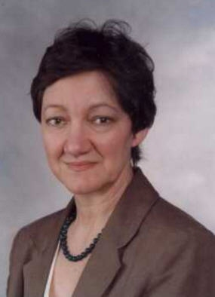


Diana Laurillard’s Conversational Framework
To Design, Develop, and Evaluate Quality Blended Learning

Slide 25
Diana Laurillard’s Conversational Framework
To Design, Develop, and Evaluate Quality Blended Learning

Slide 26
Diana Laurillard’s Conversational Framework
CONCEPT
To Design, Develop, and Evaluate Quality Blended Learning

Slide 27
Diana Laurillard’s Conversational Framework
CONCEPT
To Design, Develop, and Evaluate Quality Blended Learning

Slide 28
Diana Laurillard’s Conversational Framework
CONCEPT
To Design, Develop, and Evaluate Quality Blended Learning

Slide 29
Diana Laurillard’s Conversational Framework
CONCEPT
To Design, Develop, and Evaluate Quality Blended Learning

Slide 30
Diana Laurillard’s Conversational Framework
CONCEPT
To Design, Develop, and Evaluate Quality Blended Learning

Slide 31
Diana Laurillard’s Conversational Framework
PRE-EXISTING
KNOWLEDGE
OF CONCEPT
CONCEPT
To Design, Develop, and Evaluate Quality Blended Learning

Slide 32
Diana Laurillard’s Conversational Framework
PRE-EXISTING
KNOWLEDGE
OF CONCEPT
CONCEPT
UNIQUE
LIFE
EXPERIENCE
To Design, Develop, and Evaluate Quality Blended Learning

Slide 33
Diana Laurillard’s Conversational Framework
CONCEPT
To Design, Develop, and Evaluate Quality Blended Learning

Slide 34
Diana Laurillard’s Conversational Framework
CONCEPT
To Design, Develop, and Evaluate Quality Blended Learning

Slide 35
Diana Laurillard’s Conversational Framework
CONCEPT
To Design, Develop, and Evaluate Quality Blended Learning

Slide 36
Diana Laurillard’s Conversational Framework
PRE-EXISTING
KNOWLEDGE
OF CONCEPT
CONCEPT
To Design, Develop, and Evaluate Quality Blended Learning

Slide 37
Diana Laurillard’s Conversational Framework
PRE-EXISTING
KNOWLEDGE
OF CONCEPT
CONCEPT
UNIQUE
LIFE
EXPERIENCE
To Design, Develop, and Evaluate Quality Blended Learning

Slide 38


