Slide 1
Blended Learning International Train the Train (BLITT)
The Blended Learning Workbook
Damian Gordon
Lecturer in Computer Science
To Design, Develop, and Evaluate Quality Blended Learning

Slide 2
Let’s go back in time…
To Design, Develop, and Evaluate Quality Blended Learning

Slide 3
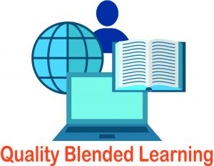
Quality Blended Learning
About 130 years ago, a number of international partners got together to develop a workbook that would help people to begin to use blended learning in a teaching context, and focusing specifically on Adult Education.
To Design, Develop, and Evaluate Quality Blended Learning

Slide 4
Quality Blended Learning
The partners were:
UPI Ljudska Univerza Žalec
DomSpain
TU Dublin
VHS Hannover
CCS Digital Education
Dlearn
To Design, Develop, and Evaluate Quality Blended Learning

Slide 5
Quality Blended Learning
The key output was:
To Design, Develop, and Evaluate Quality Blended Learning

Slide 6
Quality Blended Learning
To Design, Develop, and Evaluate Quality Blended Learning

Slide 7
Quality Blended Learning
You can do these (or get your students):
Presentations, and Prezi (and PPT morph)
Podcasts, and soundscapes
Videos, and subtitles (interactive and accessible)
Documents (interactive and accessible)
Games, and gamification
Searching, and WebQuests
Who’s presenting?
To Design, Develop, and Evaluate Quality Blended Learning

