Slide 1
CPD in Applied Blended Learning Technologies
Storyboards
Damian Gordon
Lecturer in Computer Science
To Design, Develop, and Evaluate Quality Blended Learning

Slide 2
Storyboards
“Storyboards are visual organizers, typically a series of illustrations displayed in sequence for the purpose of pre-visualizing a video, web-based training, or interactive media sequence.”
http://www.instructionaldesign.org/storyboarding.html
To Design, Develop, and Evaluate Quality Blended Learning

Slide 3
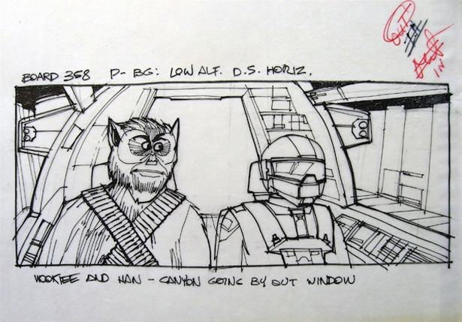
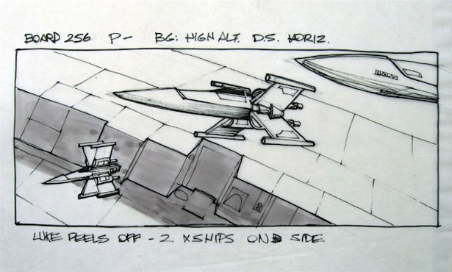
Storyboards: Star Wars
To Design, Develop, and Evaluate Quality Blended Learning

Slide 4
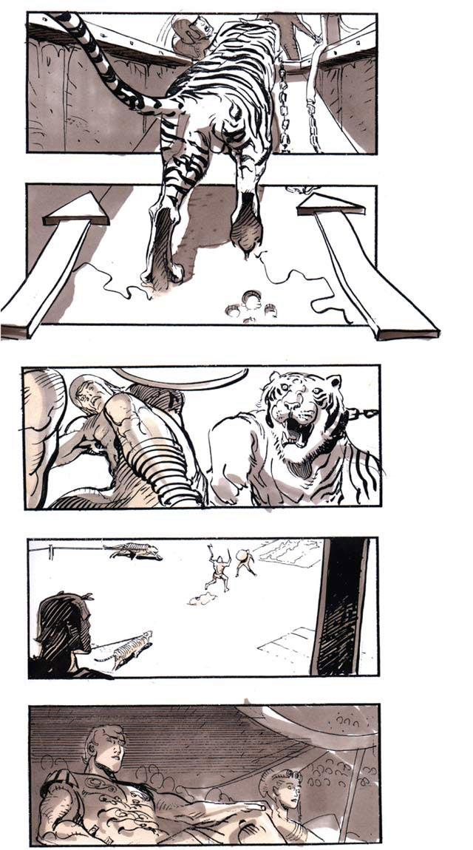
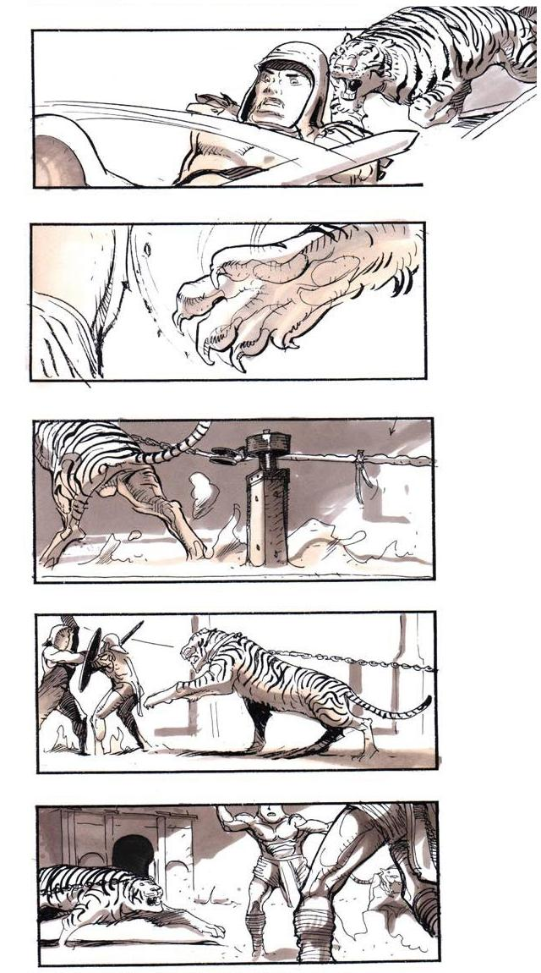
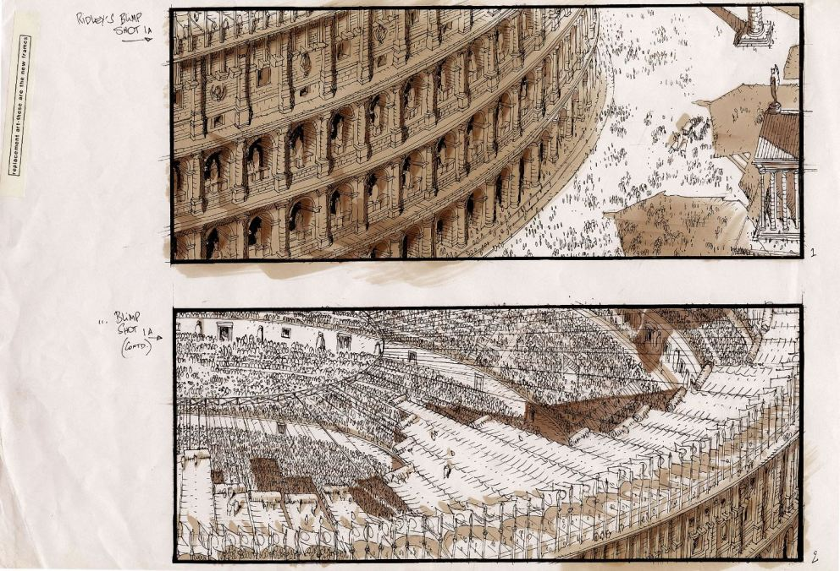
Storyboards: Gladiator
To Design, Develop, and Evaluate Quality Blended Learning

Slide 5
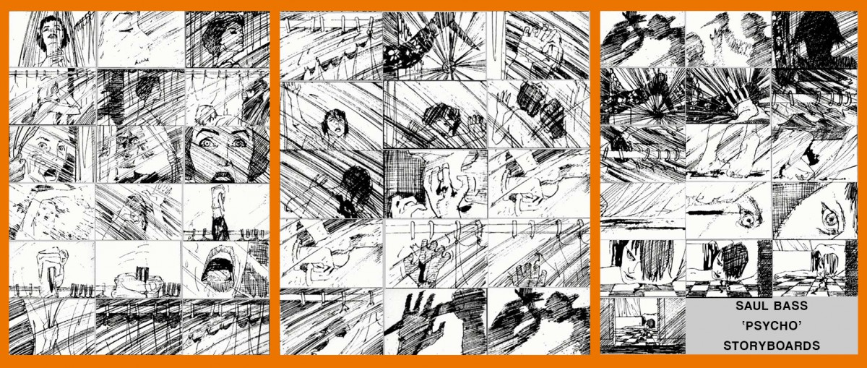
Storyboards: Psycho
To Design, Develop, and Evaluate Quality Blended Learning

Slide 6
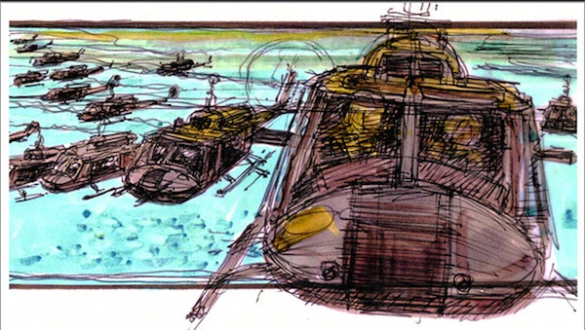
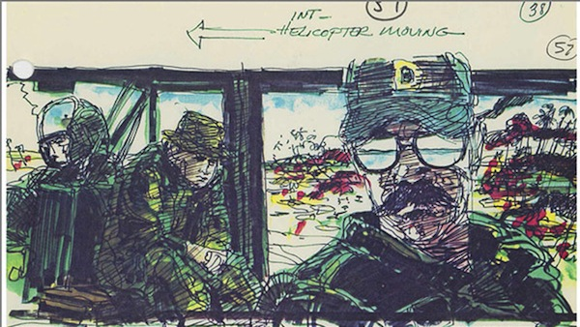
Storyboards: Apocalypse Now
To Design, Develop, and Evaluate Quality Blended Learning

Slide 7
Storyboards
Developed by Disney Studios in 1930s.
To Design, Develop, and Evaluate Quality Blended Learning

Slide 8
Storyboards
The goal of storyboarding is to get ideas down on paper and communicate effectively to all members of the team (and potentially the end-users).
They provide a tangible baseline focus for discussion, and alteration.
To Design, Develop, and Evaluate Quality Blended Learning

Slide 9
Storyboards
They are:
Inexpensive
Easy to make
Easy to understand for anyone
Good at giving you an early picture of the system
To Design, Develop, and Evaluate Quality Blended Learning

Slide 10
Storyboards
There are three types of storyboards:
Passive
Active
Interactive
To Design, Develop, and Evaluate Quality Blended Learning

Slide 11
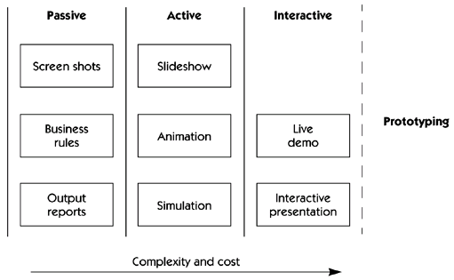
Storyboards
To Design, Develop, and Evaluate Quality Blended Learning

Slide 12
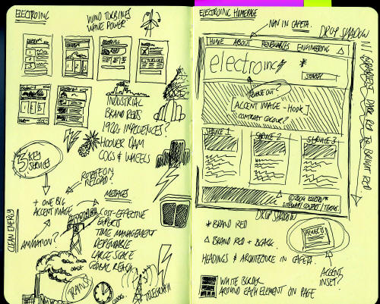
Storyboards
Passive storyboards:
Sketches, pictures, screenshots
PowerPoint or example outputs
To Design, Develop, and Evaluate Quality Blended Learning

Slide 13
Storyboards
Active storyboards:
Slideshows, simple animations
“Demo mode” of typical behaviour of system
To Design, Develop, and Evaluate Quality Blended Learning

Slide 14
Storyboards
Interactive storyboards:
Interactive tools
Requires user participation
To Design, Develop, and Evaluate Quality Blended Learning

Slide 15
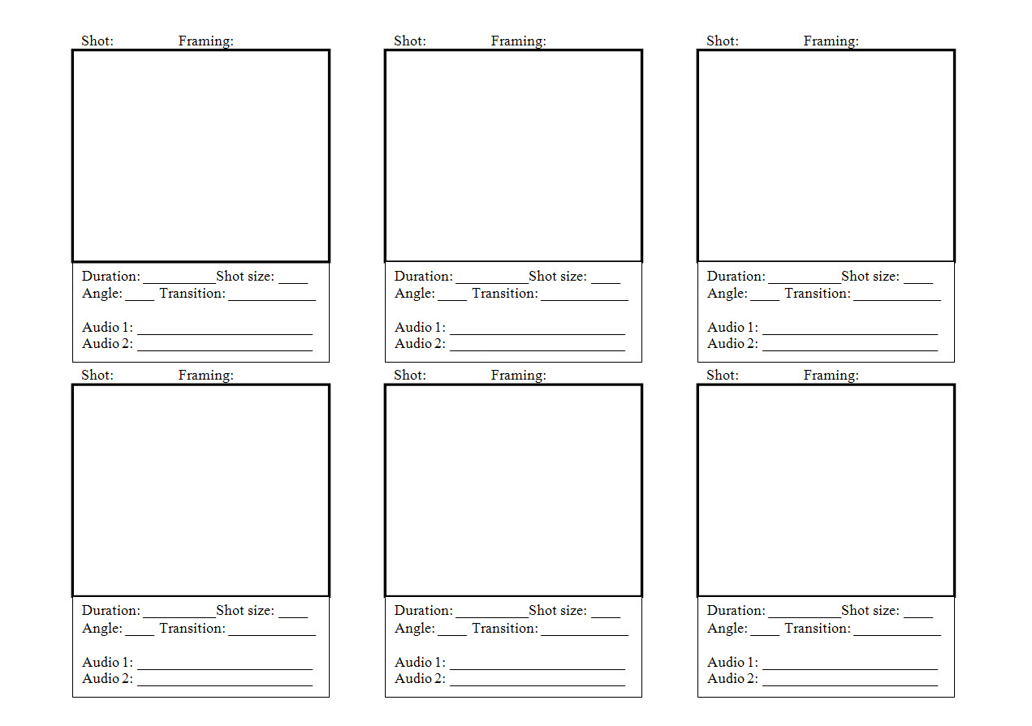
Storyboards
To Design, Develop, and Evaluate Quality Blended Learning

Slide 16
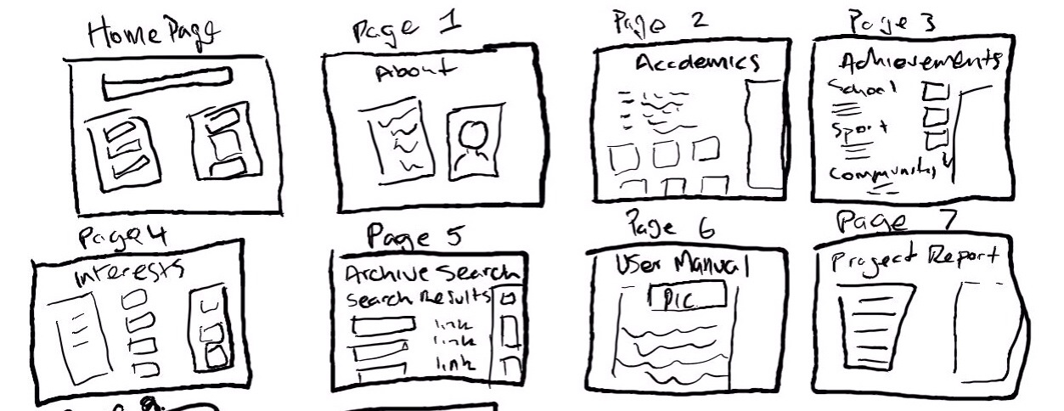
Storyboards
To Design, Develop, and Evaluate Quality Blended Learning

Slide 17
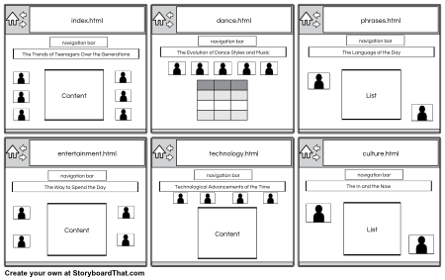
Storyboards
To Design, Develop, and Evaluate Quality Blended Learning

Slide 18
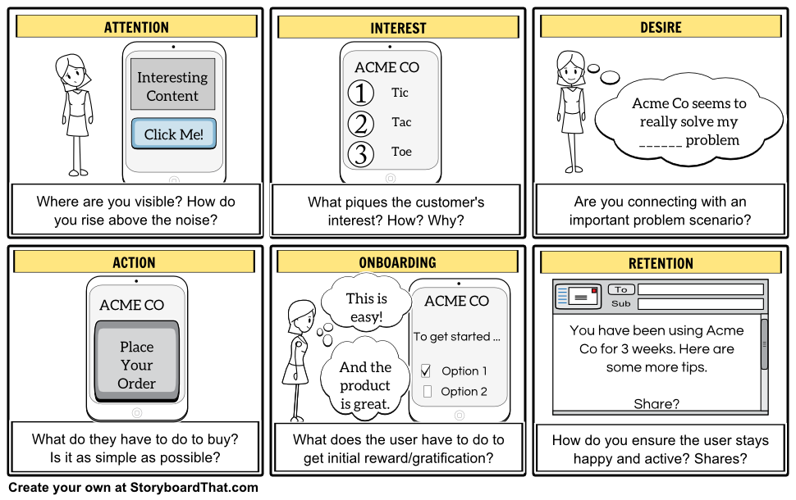
Storyboards
To Design, Develop, and Evaluate Quality Blended Learning

Slide 19
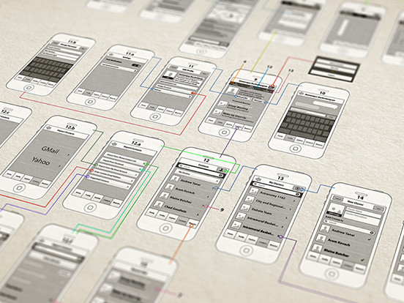
Storyboards
To Design, Develop, and Evaluate Quality Blended Learning

Slide 20
Storyboards
Celtx: http://www.celtx.com
Lectora Snap: http://lectora.com/
Articulate Storyline: http://www.articulate.com/products/storyline-overview.php
Adobe Captivate: http://www.adobe.com/products/captivate.html
To Design, Develop, and Evaluate Quality Blended Learning

Slide 21
Instructional Design and e-Authoring
Related Ideas
To Design, Develop, and Evaluate Quality Blended Learning

Slide 22
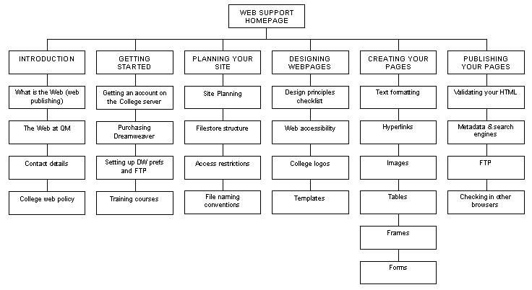
Sitemap
To Design, Develop, and Evaluate Quality Blended Learning

Slide 23
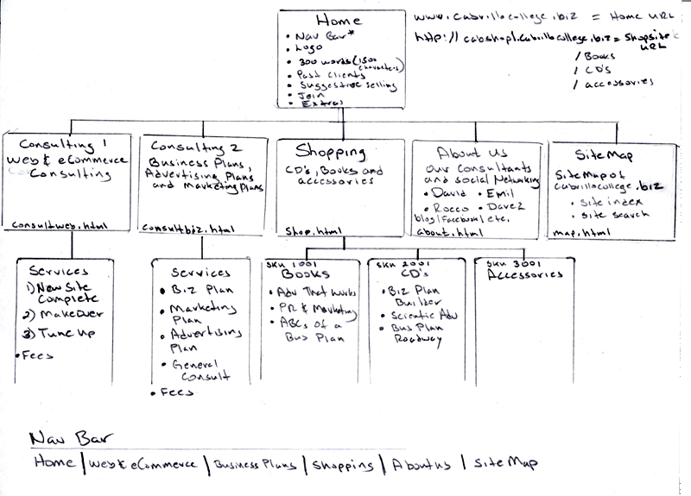
Sitemap
To Design, Develop, and Evaluate Quality Blended Learning

Slide 24
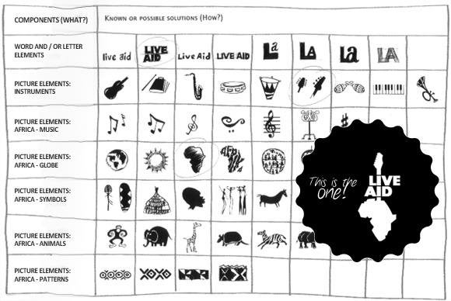
Morphological Matrix
To Design, Develop, and Evaluate Quality Blended Learning

Slide 25
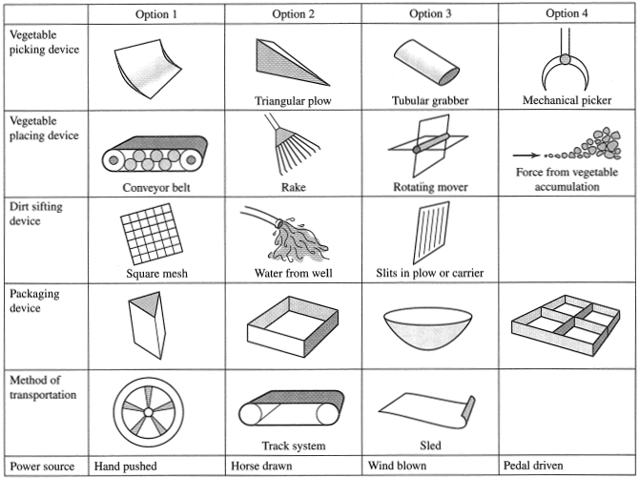
Morphological Matrix
To Design, Develop, and Evaluate Quality Blended Learning

Slide 26
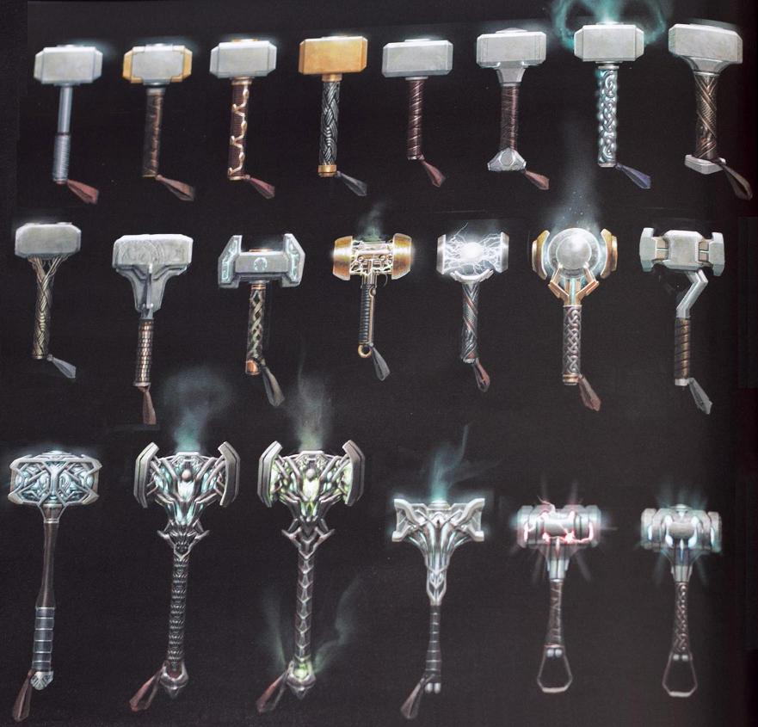
Morphological Matrix
To Design, Develop, and Evaluate Quality Blended Learning

