Slide 1
Blended Learning International Train the Train (BLITT)
Personas
Damian Gordon
Lecturer in Computer Science
To Design, Develop, and Evaluate Quality Blended Learning

Slide 2
Personas
Personas are all about building empathy amongst teams.
A persona is a fictional character that can be used to represent a collection of some of the kinds of people who could potentially be using a particular design.
To Design, Develop, and Evaluate Quality Blended Learning

Slide 3
Personas
To Design, Develop, and Evaluate Quality Blended Learning

Slide 4
Personas
Typically, in user-centred design the designers will use several personas to test the viability of a design. The personas allow the designers to consider the range of stakeholders that might be using their designs, and allows the designer to look at their designs from these stakeholders’ perspectives.
To Design, Develop, and Evaluate Quality Blended Learning

Slide 5
Personas
The need for personas was initially identified in the mid-1990s in the marketing sector, followed quickly by the software sector, and then quickly spreading to a range of design disciplines.
To Design, Develop, and Evaluate Quality Blended Learning

Slide 6
Personas
Benefits that have been suggested for personas include a suggestion that for designers working in groups, they are given a common, consistent understanding of the dimensions of diversity and can communicate and brainstorm more effectively about diversity to each other.
To Design, Develop, and Evaluate Quality Blended Learning

Slide 7
Personas
It also allows the designers to focus on the users of their design and encourages the designers to learn more about those users and understand how they will use the design.
To Design, Develop, and Evaluate Quality Blended Learning

Slide 8
Personas
Some researchers have criticised the use of personas by indicating that for evaluating a design, the use of real customers who will be using the design is more realistic and preferable to the use of personas which are fictional characters.
To Design, Develop, and Evaluate Quality Blended Learning

Slide 9
Personas
There is no doubt that using a wide range of real customers is one of the strongest forms of evaluation, but there are many cases where this is not possible, and personas are an effective alternative.
To Design, Develop, and Evaluate Quality Blended Learning

Slide 10
Personas
Some scientific studies (e.g. Frank Long, 2009, “Real or Imaginary: The effectiveness of using personas in product design”) on the use of personas have shown that personas can result in more usable designs, more user-centred discussions, and more effective communication in design teams.
To Design, Develop, and Evaluate Quality Blended Learning

Slide 11
Personas
To Design, Develop, and Evaluate Quality Blended Learning

Slide 12
Personas
Choose questions for your survey
Set up a survey on a popular page
Analyze your data
Build your persona
https://www.hubspot.com/make-my-persona
https://medium.com/beakerandflint/personas-74c4e1c12ee2
To Design, Develop, and Evaluate Quality Blended Learning

Slide 13
Personas
Identify behavioural variables
Map survey subjects to behavioural variables
Identify significant behaviour patterns
Synthesise characteristics and relevant goals
Check for completeness and redundancy
Expand description of attributes and behaviours
Designate persona types
To Design, Develop, and Evaluate Quality Blended Learning

Slide 14
Personas
A useful persona is not just a demographic, it is always more than an age and a job title, because it helps you understand the motivations, fears, and concerns of your ideal customer and market.
A useful persona includes features that you don’t agree with and isn’t your organisational narrative.
To Design, Develop, and Evaluate Quality Blended Learning

Slide 15
Instructional Design and e-Authoring
User Stories
Damian Gordon, Dr. Claire McAvinia
To Design, Develop, and Evaluate Quality Blended Learning

Slide 16
User Stories
A user story is one or more sentences in the everyday language that captures what a user does or needs to do as part of their job function.
To Design, Develop, and Evaluate Quality Blended Learning

Slide 17
User Stories
For example:
As a user, I want to search for my customers both by their first and last names.
As a non-administrative user, I want to modify my own schedules but not the schedules of other users.
To Design, Develop, and Evaluate Quality Blended Learning

Slide 18
User Stories
User stories are often written from the perspective of an end-user or user of a system.
To Design, Develop, and Evaluate Quality Blended Learning

Slide 19
User Stories
They are often recorded on index cards, on Post-it notes, or in project management software.
To Design, Develop, and Evaluate Quality Blended Learning

Slide 20
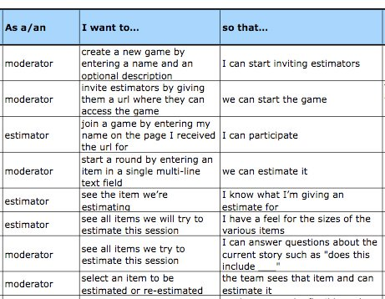
User Stories
To Design, Develop, and Evaluate Quality Blended Learning

