Slide 1
Students with Disabilities and the School of Computing: Raising Awareness
Art Sloan

Slide 2
Students with Disabilities – Finding Their Way
Online Direction

Slide 3
DIT’s Online Help for Students with Disability
All students of DIT can find their way to the Disability Support Service website, which links to further support descriptions on other pages.
The support service page itself is linked from the Health and Wellbeing list on the ‘Information for Current Students’ page.

Slide 4
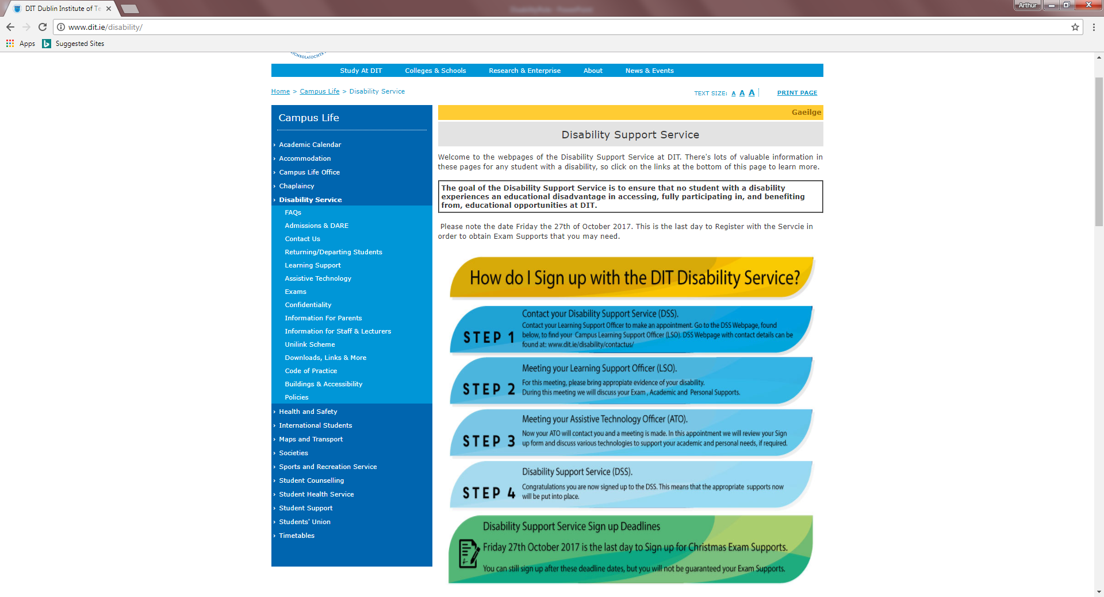

Slide 5
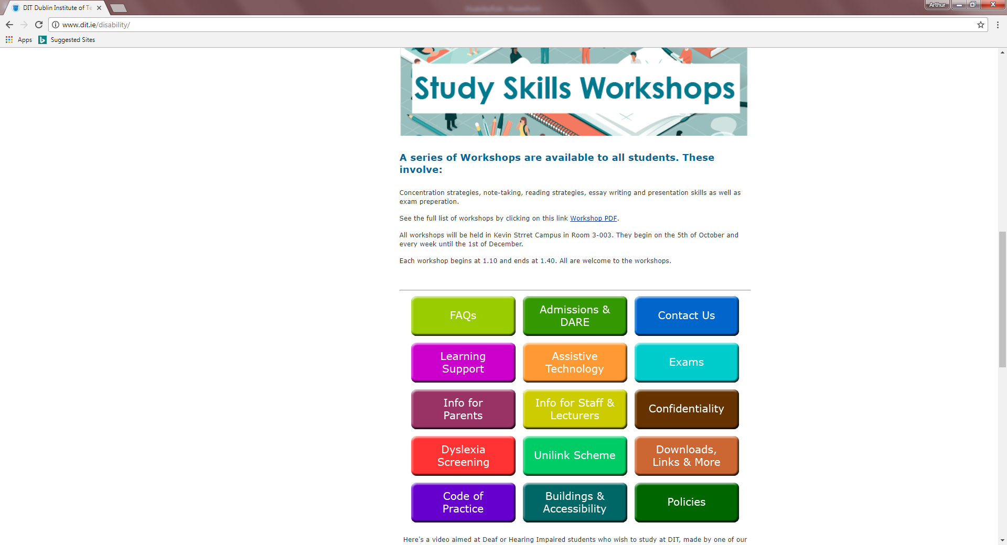

Slide 6
People in Support
Deirdre Staunton, Head of Disability Support Service
Sylvia Mooney, Learning Support Officer (There are 5 others in other sites)
Art Sloan, Disability Liaison Officer (School of Computing)
(There are no others in other Schools)

Slide 7
Induction Day
During Induction Day, at some stage, I (Art) will introduce myself as the School of Computing’s Disability Liaison Officer and offer to be contacted to answer questions and guide those new students who consider themselves to have a disability.
Guidance involves introducing them to Sylvia Mooney, Kevin Street’s Learning Support Officer.
Sylvia will set a time to discuss and assess each student’s needs.
Students have to present themselves for this process, and ask, sometimes, for specific services.

Slide 8
How Many Do We Have?
In the School of Computing?
On our Courses?

Slide 9
Student’s Registered for Learning Supports
Total in the School of Computing: 53
DT211C: 18
DT228: 30
DT282: 5

Slide 10
The Main Conditions / Diagnoses
Anxiety (with or without Depression)
Attention Deficit Disorder / Attention Deficit Hyperactivity Disorder
(ADD /ADHD)
Autism Spectrum (Asperger’s Syndrome)
Dyslexia / Dyscalculia
Dyspraxia / Dysgraphia

Slide 12
The Numbers by Course
DT211C
Dyslexia/Discalculia | 9
Asperger's | 3
Dyspraxia/Dysgraphia | 3
Anxiety | 2
ADD/ADHD | 1
DT228
Dyslexia/Discalculia | 15
Asperger's | 6
Dyspraxia/Dysgraphia | 5
Anxiety | 5
ADD/ADHD | 2
DT282
Dyslexia/Discalculia | 1
Asperger's | 1
Dyspraxia/Dysgraphia | 0
Anxiety | 0
ADD/ADHD | 1

Slide 14
Looking After Registered Students
What Does the Disabilities Liaison Officer Do?

Slide 15
Gathering the Details
I meet with Sylvia Mooney in September (to get an idea of the numbers coming into First Year) and again in October (to get more specific numbers of registered students in each course).
Sylvia gives me a list of names and details from a database.
I refine the lists to suit Course Chairs, Mentors and Lecturers per Course/Year and email them out to these individuals.

Slide 16
Gathering the Details (2)
Sylvia Mooney sometimes receives ENAs (Educational Needs Assessment Forms).
These move through Registrations and the Disability Support Service – but not all are passed on.
(ANOMALY)
I have received a few, but many are missing.
I have the option (?) of passing these on to lecturers of each of the students.
I have, this year, focused on the spreadsheet lists, and passed these on, as mentioned before, with summary accounts of needs.

Slide 17
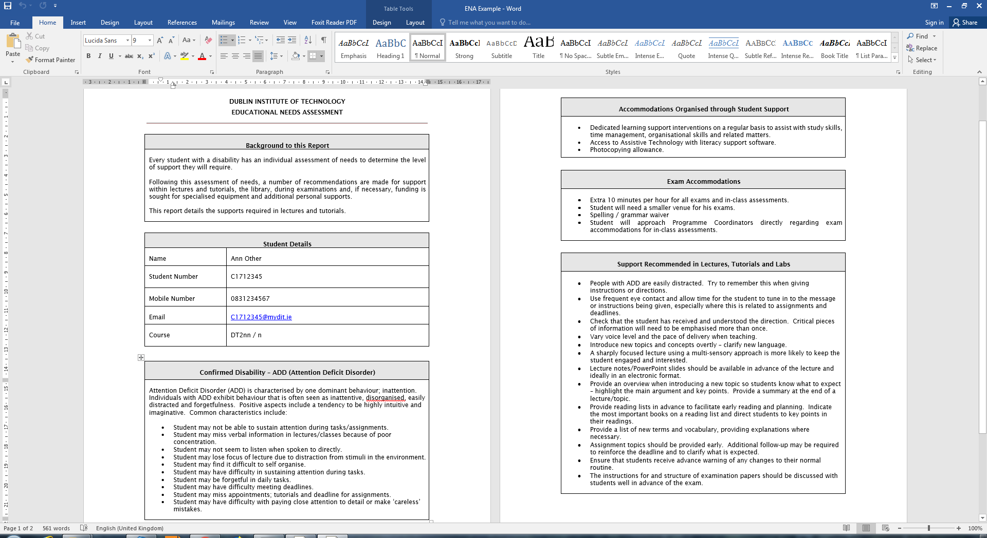

Slide 18
Meeting Students
I meet with students, on an ad hoc basis, throughout the year.
Some years there are a few short meetings, listening to circumstances and guiding the student to the requisite support within DIT.
Other years (like this one so far) there are frequent phone conversations, emails and meetings – all to provide morals support, information and guidance.

Slide 19
Who Else Helps?
Often the students need to be guided to meet with:
Medical Centre (Aungier Street)
Counselling Service (Aungier Street)
Chaplaincy

Slide 20
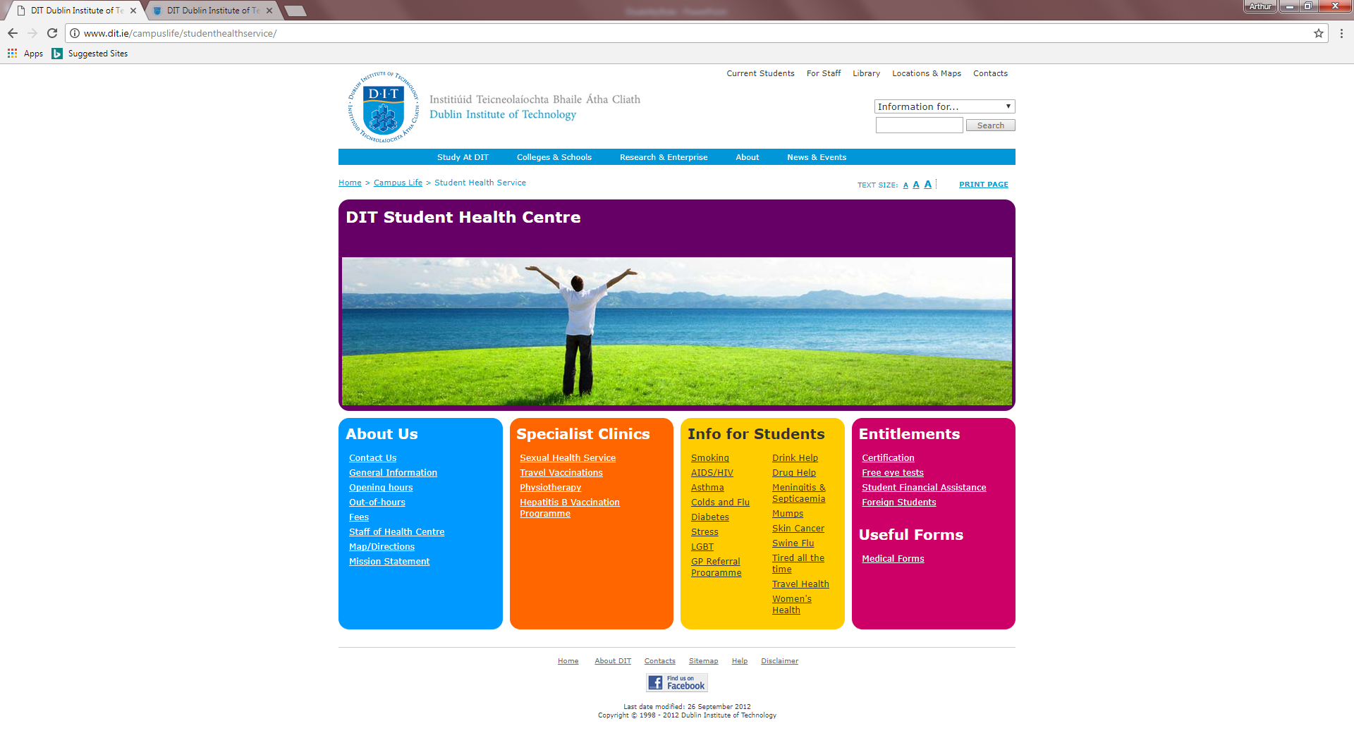
Who Else Helps? (2)

Slide 21
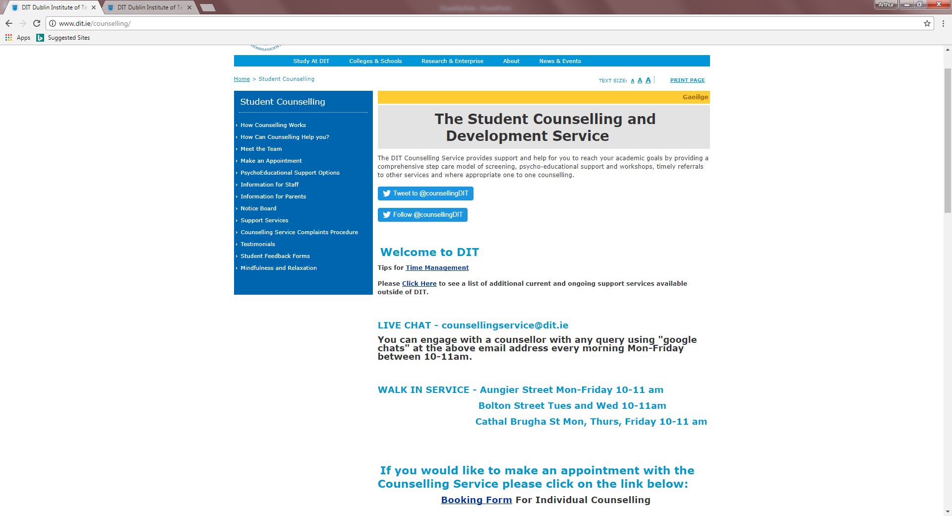
Who Else Helps? (3)

Slide 22
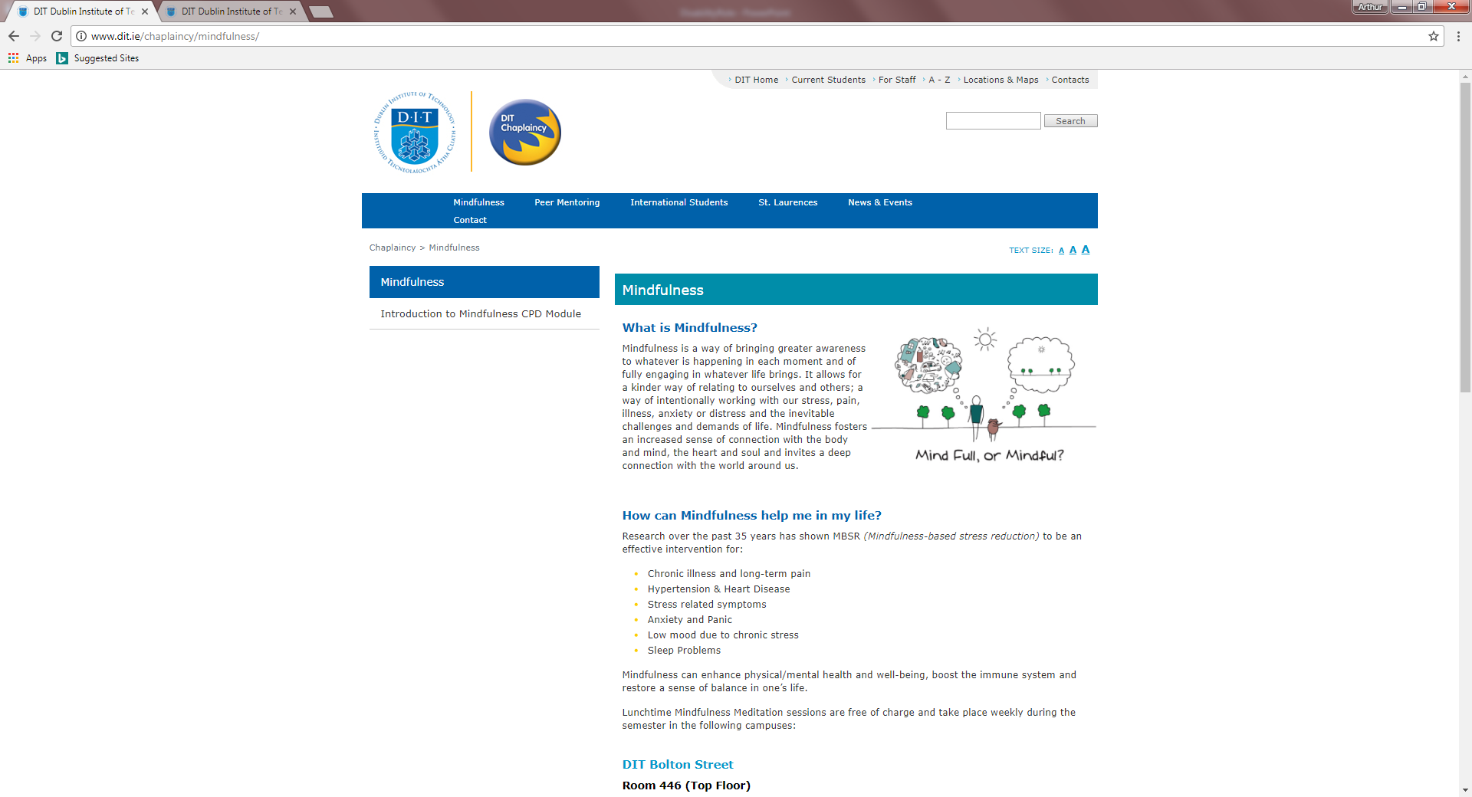
Who Else Helps? (4)

Slide 23
Other Tasks
The meetings with Sylvia Mooney continue throughout the year.
At least one long discussion per month. (Updating student details, ticking off those withdrawing…)
Reactive situations: students have immediate problems through the year, which I may need to attend to. (Infrequent)
Forms to be signed / letters written. (Occasionally)
Lots of emails….

Slide 24
Your View
What do You Need to do?

Slide 25
Lecturers and Registered Students
Be aware.
If you are made aware of a disabilities-related problem by a student, send them MY way!
Watch out for manifestations of their disability.
Care for them – if you can. (Through your own work as an assessor and content presenter.)

Slide 26
The End
Supporting students with disability is my responsibility, but you can help me to look after them. (Let’s communicate! …I promise to!)

