Slide 1
Dyspraxia

Slide 2
Dyspraxia
http://www.dyspraxia.ie
It is a developmental co-ordination disorder, affecting fine and/or gross motor coordination in children and adults.

Slide 3
Dyspraxia
What’s it like?

Slide 4
Dyspraxia
What’s it like?
It’s different for different people.
U
A
B

Slide 5
Dyspraxia
Poor balance
Poor fine and/or gross motor co-ordination
Poor posture
Confused about which hand to use
Difficulty with reading, writing
Speech problems - slow to learn to speak and speech may be incoherent
Phobias or obsessive behaviour and impatient

Slide 6
Help the Student to Prepare for Class by:
Giving them your notes a few days before class.
Giving them labs a few days before the lab (if possible).
Explaining the key words first before they are used when discussing that topic in class.

Slide 7
Help the Student in the Class by:
Using images and diagrams where possible (and help learners devise their own pictures and diagrams).
Breaking a longer sentence into a few shorter ones (and using a larger font where possible).
Making sure they are seated near the front (if they need help), and are away from windows, doors and other distractions.
Providing breaks in the schedule (to give the students a chance to stretch and catch up).

Slide 8
Help the Student in Tests and Assignments by:
Arranging tests and assignments to work from easiest to hardest problems.
Considering allowing the student to use speech-to-text software.
Breaking down tests and assignments into small parts (using new paragraphs and bullet points to break things up).
Providing them with extended time for testing.

Slide 9
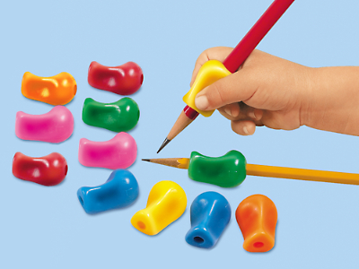
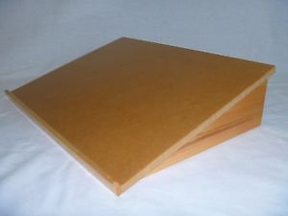

Slide 10

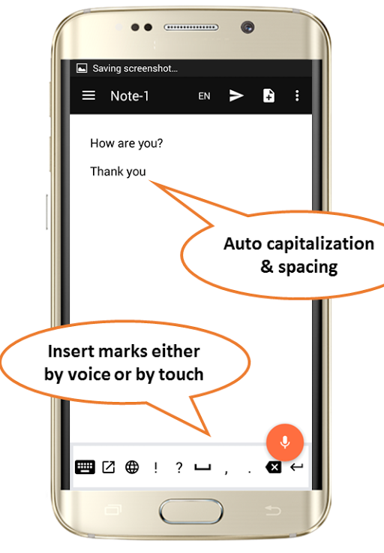
Free Speech-to-Text Online Notepad
https://speechnotes.co

Slide 11
Thanks !!!
Please contact me if you have any comments or suggestions:
Damian.Gordon@dit.ie

