Slide 1
Dysgraphia

Slide 2
Dysgraphia
https://www.sess.ie/categories/specific-learning-disabilities/dysgraphia
Dysgraphia is a disorder of handwriting primarily that causes a student’s handwriting to be almost illegible, and makes it very difficult to learn to spell. It can be often associated with a very high verbal IQ.

Slide 3
Dysgraphia
Dysgraphia often co-occurs with other learning disabilities like:
Speech Impairment
Attention Deficit Hyperactive Disorder
Developmental Coordination Disorder

Slide 4
Dysgraphia
What’s it like?

Slide 5
Dysgraphia
What’s it like?
It’s different for different people.
U
A
B

Slide 6
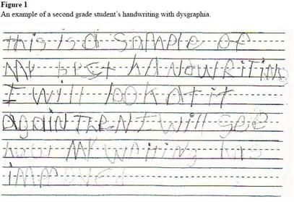
Dysgraphia

Slide 7
Help the Student to Prepare for Class by:
Giving them your notes a few days before class.
Giving them labs a few days before the lab (if possible).
Explaining the key words first before they are used when discussing that topic in class.

Slide 8
Help the Student in the Class by:
Using images and diagrams where possible (and help learners devise their own pictures and diagrams).
Breaking a longer sentence into a few shorter ones.
Providing a lesson outline for helping take notes.
Providing breaks in the schedule (to give the students a chance to stretch and catch up).

Slide 9
Help the Student in Tests and Assignments by:
Arranging tests and assignments to work from easiest to hardest problems.
Considering allowing the student to use speech-to-text software.
Breaking down tests and assignments into small parts (using new paragraphs and bullet points to break things up).
Providing them with extended time for testing.

Slide 10
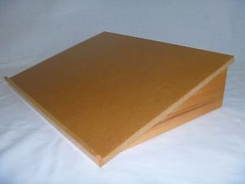

Slide 11
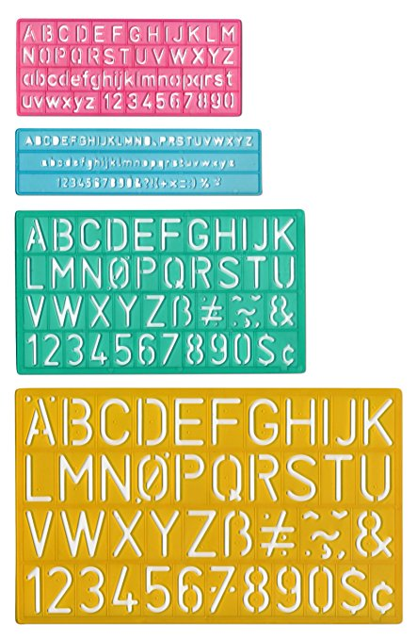

Slide 12
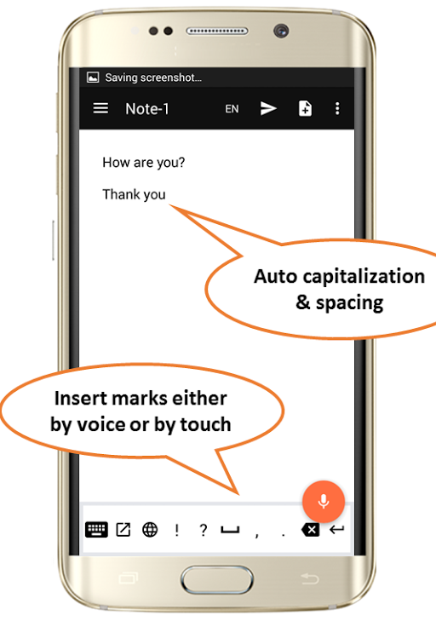
Free Speech-to-Text Online Notepad
https://speechnotes.co

Slide 13
Thanks !!! Please contact me if you have any comments or suggestions: Damian.Gordon@dit.ie

