Slide 1
Autism Spectrum

Slide 2
Autism
https://autismireland.ie
Autism generally results in having difficulty with social interactions and exhibiting a restricted range of interests and/or repetitive behaviours.

Slide 3
Autism
What’s it like?

Slide 4
Autism
What’s it like?
It’s different for different people.
U
A
B

Slide 5
Autism
What’s it like?

Slide 6
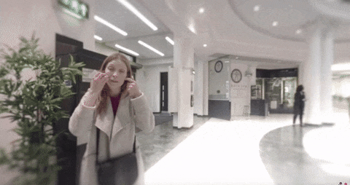
http://www.autism.org.uk/VR

Slide 7
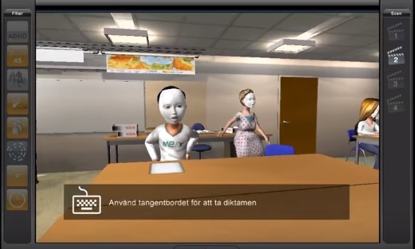
https://www.youtube.com/watch?v=_3R0a64UW3g

Slide 8
Autism
Students with Autism may:
Yawn in class, or laugh or giggle (inappropriately).
Echo words or phrases said by you or others.
Insist on sameness.
Use gestures instead of words to indicate their needs.
Not like to be asked a lot of questions in class.
Not like hugs or cuddles.

Slide 9
Help the Student to Prepare for Class by:
Giving them your notes a few days before class.
Giving them labs a few days before the lab (if possible).
Explaining the key words first before they are used when discussing that topic in class.

Slide 10
Help the Student in the Class by:
Using images and diagrams where possible.
Repeating and rephrasing key points throughout the class.
Clearly indicate when you are transitioning away from the topic, e.g. if you are telling an anecdote.
Try to avoid slang or idiomatic speech (and avoid sarcasm, it may inadvertently reinforce inappropriate learning)

Slide 11
Help the Student in Tests and Assignments by:
Not penalizing them for spelling errors.
Understanding that many students with Asperger’s have handwriting deficits, so allowing extra time for handwritten work and explore the use of word processors.
Breaking down tests and assignments into small parts (using new paragraphs and bullet points to break things up).
Do not expect skills learned in one setting to generalize to another setting. Teach the skill and rehearse it in a variety of settings.

Slide 12
A visual schedule or visual diary.

Slide 13
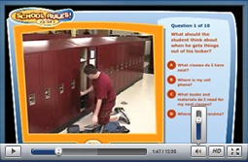
http://www.socialskillbuilder.com

Slide 14
Thanks !!! Please contact me if you have any comments or suggestions: Damian.Gordon@dit.ie

