Slide 1
Anxiety Disorder

Slide 2
Anxiety Disorder
https://www.hse.ie/eng/health/az/A/Anxiety/Treating-anxiety.html
Anxiety disorders the name for a group of mental disorders that create so much distress that they can keep people from carrying on their lives normally. For people who have one, worry and fear are constant and overwhelming.

Slide 3
Anxiety Disorder
What’s it like?

Slide 4
Anxiety Disorder
What’s it like?
It’s different for different people.
U
A
B

Slide 5
Anxiety Disorder
Anxiety disorder is an umbrella term that includes different conditions:
Panic disorder: Panic attacks that strike at random, and can include sweat, chest pains, and heart palpitations.
Social anxiety disorder. Worry and self-consciousness about everyday social situations.
Specific phobias: Intense fear of a specific object or situation.
Generalized anxiety disorder: Excessive worry and tension with little or no obvious reason.

Slide 6
Help the Student to Prepare for Class by:
Giving them your notes a few days before class.
Giving them labs a few days before the lab (if possible).
Explaining the key words first before they are used when discussing that topic in class.

Slide 7
Help the Student in the Class by:
Using images and diagrams where possible.
Repeating and rephrasing key points throughout the class.
Allow them to sit near a door where they will be able to exit quickly if they get an anxiety attack.
Providing breaks in the schedule (to give the students a chance to stretch and calm down).

Slide 8
Help the Student in Tests and Assignments by:
Making sure they are working in a quiet area (to reduce anxiety).
Allow them to sit near a door where they will be able to exit quickly if they get an anxiety attack.
If taking a test triggers them consider providing an alternative.
Providing them with extended time for testing.

Slide 11
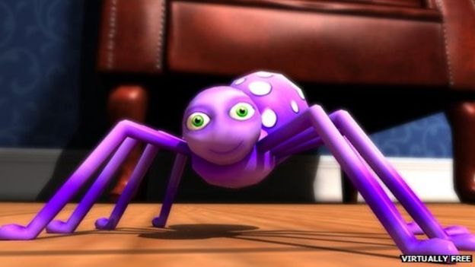
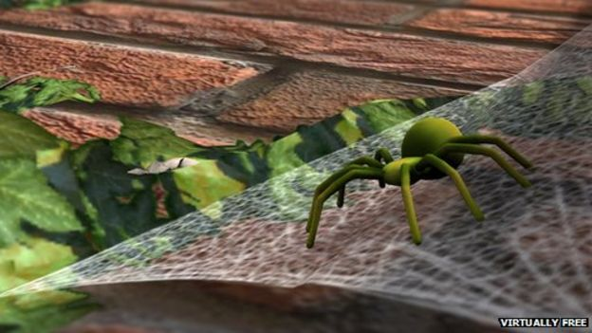
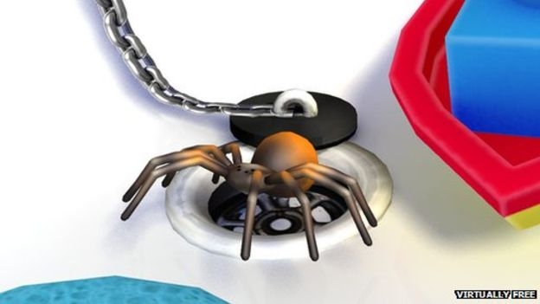
https://thrive.uk.com/phobia-apps/

Slide 12
Thanks !!! Please contact me if you have any comments or suggestions: Damian.Gordon@dit.ie

