Slide 1
ADHD

Slide 2
ADHD
http://www.hadd.ie
ADHD is Attention Deficit Hyperactivity Disorder, which is a broad term, and the condition can vary from person to person. It is generally understood to describe students who have trouble focusing.

Slide 3
ADHD
It supersedes the previous (outdated) term Attention Deficit Disorder (ADD).

Slide 4
ADHD
There are three types of ADHD:
Inattentive ADHD is when a person shows enough symptoms of inattention, or distractibility, but isn’t hyperactive or impulsive.
Hyperactive/impulsive ADHD is when a person has symptoms of hyperactivity and impulsivity but not inattention.
Combined ADHD is when a person has symptoms of inattention, hyperactivity, and impulsivity.

Slide 5
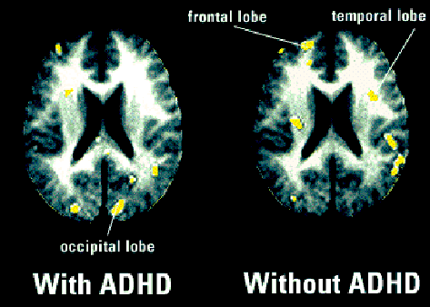

Slide 6
Help the Student to Prepare for Class by:
Giving them your notes a few days before class.
Giving them labs a few days before the lab (if possible).
Explaining the key words first before they are used when discussing that topic in class.

Slide 7
Help the Student in the Class by:
Using images and diagrams where possible (and help learners devise their own pictures and diagrams).
Use a visual signal (e.g. something shiny) to get their attention.
Making sure they are seated near the front (if they need help), and are away from windows, doors and other distractions.
Providing breaks in the schedule (to give the students a chance to take a break).

Slide 8
Help the Student in Tests and Assignments by:
Arranging tests and assignments to work from easiest to hardest problems.
Considering allowing the student to use a word processor.
Breaking down tests and assignments into small parts (using new paragraphs and bullet points to break things up).
Providing them with extended time for testing.

Slide 10
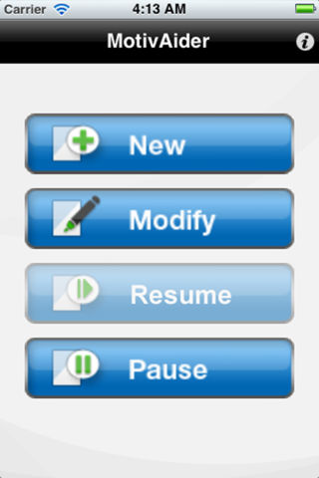
http://habitchange.com/iphone_app.php

Slide 11
Thanks !!! Please contact me if you have any comments or suggestions: Damian.Gordon@dit.ie

