Slide 1
Accommodations for Diverse Students
Damian Gordon

Slide 2
Visual Cue/ Graphic Organiser
Accommodations for Diverse Students
Specific Learning Difficulties
Dyslexia
Dyspraxia
Asperger's Syndrome
Anxiety
Disorder
ADHD
Dyscalculia
Dysgraphia
Final Thoughts

Slide 3
Specific Learning Difficulties

Slide 4
Specific Learning Difficulties
Also known as Specific Developmental Disorder.
Specific learning difficulties include:
Dyslexia | Challenges with reading and spelling
Dyspraxia | Challenges with fine and/or gross motor skills
Asperger's Syndrome | Challenges with social and communication skills
Attention Deficit Hyperactive Disorder (ADHD) | Challenges with attention and concentration

Slide 5
Dyslexia

Slide 6
Dyslexia
http://www.dyslexia.ie
A specific learning difficulty which makes it harder for some people to learn, to read, write and spell.

Slide 7
Dyslexia
What’s it like?

Slide 8
Dyslexia
What’s it like?
It’s different for different people.
U
A
B

Slide 9
Dyslexia
What’s it like?

Slide 10
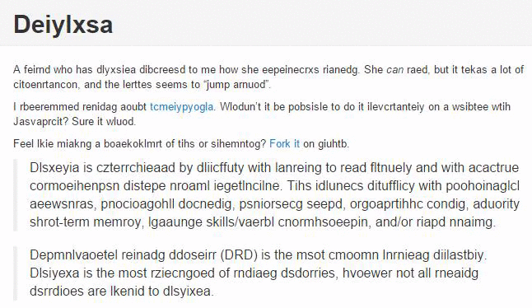

Slide 11
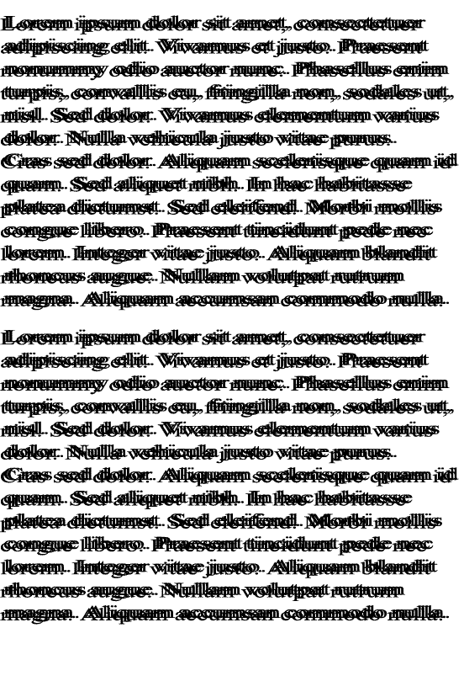

Slide 12
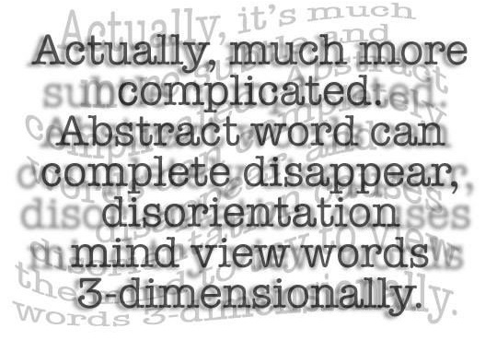

Slide 13
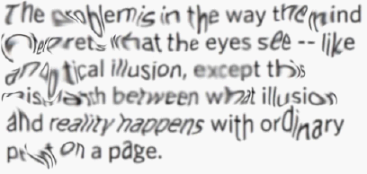

Slide 14
Dyslexia
The Dyslexia Association of Ireland (DAI) recommends the use of san serif fonts such as Arial, Comic Sans, Verdana or Sassoon.
Arial
Comic Sans
Verdana
Sassoon

Slide 15
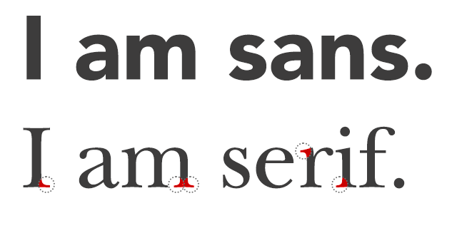
Dyslexia
The Dyslexia Association of Ireland (DAI) recommends the use of san serif fonts such as Arial, Comic Sans, Verdana or Sassoon.
Arial
Comic Sans
Verdana
Sassoon

Slide 16
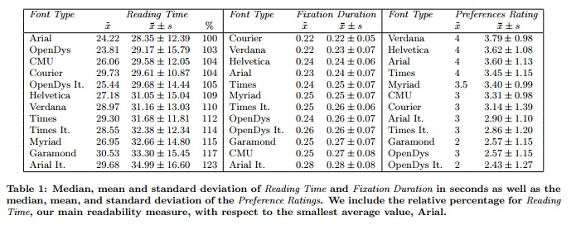
Dyslexia
Rello, L., Baeza-Yates, R. (2013) “Good Fonts for Dyslexia”, In Proceedings of the 15th International ACM SIGACCESS Conference on Computers and Accessibility (p. 14). ACM.

Slide 17
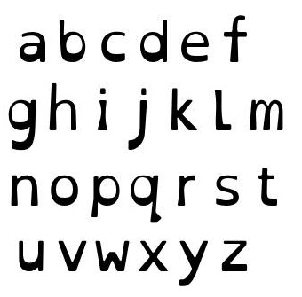
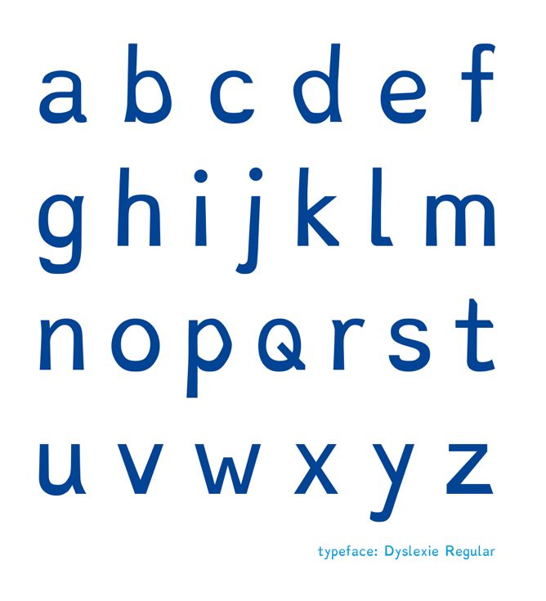
Dyslexia
Open Dyslexic Font:
https://opendyslexic.org
Dyslexie Font:
https://www.dyslexiefont.com/en/typeface/

Slide 18
An aside…
And it’s best to avoid examples that use single letter pairs, such as:
p,q
p,d
b,d
b,q

Slide 19
Dyslexia

Slide 20
Dyscalculia

Slide 21
Dyscalculia
http://www.dyscalculia.org
Dyscalculia is a specific learning disability affecting numbers and maths (it’s really about an inability to conceptualise numbers)

Slide 22
Dyscalculia
Other names:
Disorder in Mathematics (SLD-Math)
Math Learning Disability (MLD)
Developmental Dyscalculia (DD)
Acalculia
Gerstmann's Syndrome
Math Dyslexia
Math Anxiety
Numerical Impairment
Number Agnosia
Nonverbal Learning Disorder / Disability (NLD)

Slide 23
Dyscalculia
What’s it like?

Slide 24
Dyscalculia
What’s it like?
It’s different for different people.
U
A
B

Slide 26
Dyscalculia
Has issues with counting.
Has issues with using counting strategies for addition.
Has difficulties in memorizing arithmetic facts.
Has struggles to apply math concepts to money.
Has a hard time grasping information shown on graphs or charts.
Has trouble finding different approaches to the same math problem.

Slide 27
vCalc has a library of free online calculators pre-built with specific formulas for specific tasks. Just search for your task. Use for conversions, research, math, algebra, calculus, engineering, work or school. There are specific calculators for tasks in nursing, physics, chemistry, engineering, business, education, construction, finance, science, calendars, and ancient and foreign measures.

Slide 28
Dyspraxia

Slide 29
Dyspraxia
http://www.dyspraxia.ie
It is a developmental co-ordination disorder, affecting fine and/or gross motor coordination in children and adults.

Slide 30
Dyspraxia
What’s it like?

Slide 31
Dyspraxia
What’s it like?
It’s different for different people.
U
A
B

Slide 32
Dyspraxia
Poor balance
Poor fine and/or gross motor co-ordination
Poor posture
Confused about which hand to use
Difficulty with reading, writing
Speech problems - slow to learn to speak and speech may be incoherent
Phobias or obsessive behaviour and impatient

Slide 33
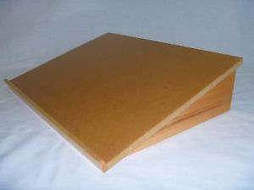

Slide 34
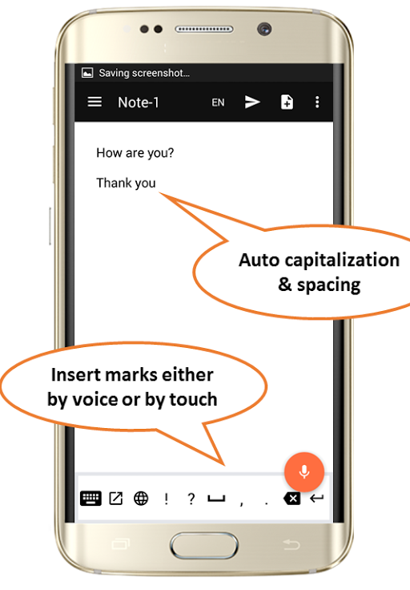
Free Speech-to-Text Online Notepad
https://speechnotes.co

Slide 35
Dysgraphia

Slide 36
Dysgraphia
https://www.sess.ie/categories/specific-learning-disabilities/dysgraphia
Dysgraphia is a disorder of handwriting primarily that causes a student’s handwriting to be almost illegible, and makes it very difficult to learn to spell. It can be often associated with a very high verbal IQ.

Slide 37
Dysgraphia
Dysgraphia often co-occurs with other learning disabilities like:
Speech Impairment
Attention Deficit Hyperactive Disorder
Developmental Coordination Disorder

Slide 38
Dysgraphia
What’s it like?

Slide 39
Dysgraphia
What’s it like?
It’s different for different people.
U
A
B

Slide 40
Dysgraphia

Slide 42
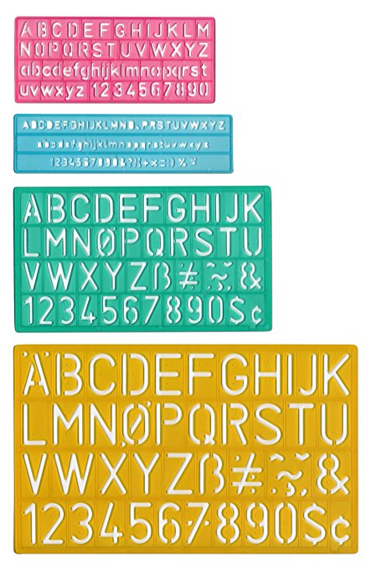

Slide 43
Free Speech-to-Text Online Notepad
https://speechnotes.co

Slide 44
Autism Spectrum: Asperger’s Syndrome

Slide 45
Asperger’s Syndrome
https://autismireland.ie
Asperger syndrome was generally considered to be on the “high functioning” end of the autism spectrum, it generally results in having difficulty with social interactions and exhibiting a restricted range of interests and/or repetitive behaviours.

Slide 46
Asperger’s Syndrome
What’s it like?

Slide 47
Asperger’s Syndrome
What’s it like?
It’s different for different people.
U
A
B

Slide 48
Asperger’s Syndrome
What’s it like?

Slide 49
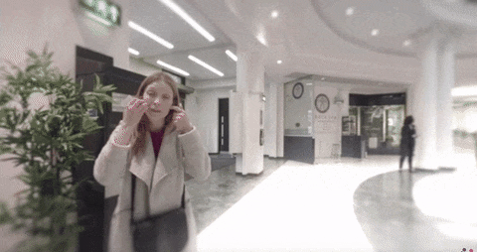
http://www.autism.org.uk/VR

Slide 50
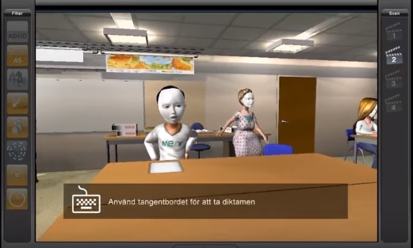
https://www.youtube.com/watch?v=_3R0a64UW3g

Slide 51
Asperger’s Syndrome
Students with Asperger’s Syndrome may:
Yawn in class, or laugh or giggle (inappropriately).
Echo words or phrases said by you or others.
Insist on sameness.
Use gestures instead of words to indicate their needs.
Not like to be asked a lot of questions in class.
Not like hugs or cuddles.

Slide 52
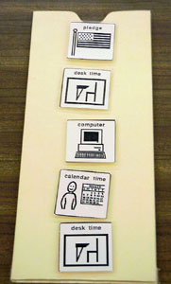
A visual schedule or visual diary.

Slide 53
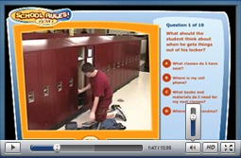
http://www.socialskillbuilder.com

Slide 54
Anxiety Disorder

Slide 55
Anxiety Disorder
https://www.hse.ie/eng/health/az/A/Anxiety/Treating-anxiety.html
Anxiety disorders the name for a group of mental disorders that create so much distress that they can keep people from carrying on their lives normally. For people who have one, worry and fear are constant and overwhelming.

Slide 56
Anxiety Disorder
What’s it like?

Slide 57
Anxiety Disorder
What’s it like?
It’s different for different people.
U
A
B

Slide 58
Anxiety Disorder
Anxiety disorder is an umbrella term that includes different conditions:
Panic disorder: Panic attacks that strike at random, and can include sweat, chest pains, and heart palpitations.
Social anxiety disorder. Worry and self-consciousness about everyday social situations.
Specific phobias: Intense fear of a specific object or situation.
Generalized anxiety disorder: Excessive worry and tension with little or no obvious reason.

Slide 61
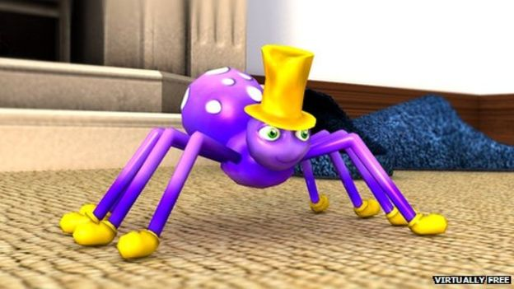
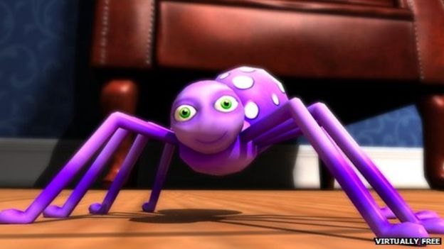
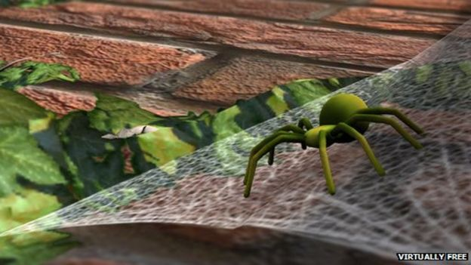
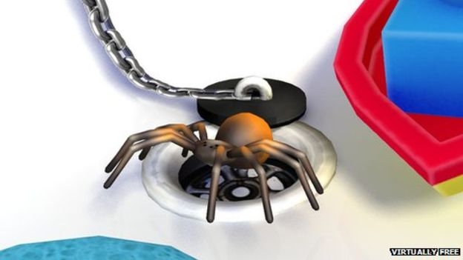
https://thrive.uk.com/phobia-apps/

Slide 62
ADHD

Slide 63
ADHD
http://www.hadd.ie
ADHD is Attention Deficit Hyperactivity Disorder, which is a broad term, and the condition can vary from person to person. It is generally understood to describe students who have trouble focusing.

Slide 64
ADHD
It supersedes the previous (outdated) term Attention Deficit Disorder (ADD).

Slide 65
ADHD
There are three types of ADHD:
Inattentive ADHD is when a person shows enough symptoms of inattention, or distractibility, but isn’t hyperactive or impulsive.
Hyperactive/impulsive ADHD is when a person has symptoms of hyperactivity and impulsivity but not inattention.
Combined ADHD is when a person has symptoms of inattention, hyperactivity, and impulsivity.

Slide 66
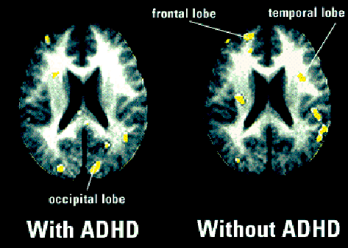

Slide 68
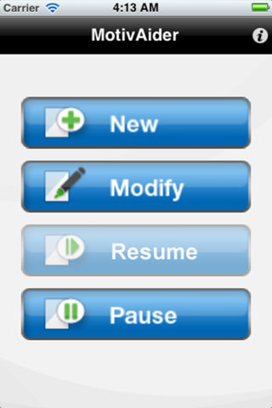
http://habitchange.com/iphone_app.php

Slide 69
Final Thoughts

Slide 70
Final thoughts:
Instead of trying to consider a diverse range of accommadations, maybe just aim for the common ones (this ties into a broader principle of Universal Design for Learning):

Slide 71
Help the Student to Prepare for Class by:
Giving them your notes a few days before class.
Giving them labs a few days before the lab (if possible).
Explaining the key words first before they are used when discussing that topic in class.
Putting documents in DOC or PPT, but not PDF.

Slide 72
Help the Student in the Class by:
Using images and diagrams where possible.
Repeating and rephrasing key points throughout the class.
Speaking clearly and using gestures to emphasise key points.
Providing model answers where possible.

Slide 73
Help the Student in Tests and Assignments by:
Making sure they are working in a quiet area.
Not penalizing them for spelling errors.
Breaking down tests and assignments into small parts (using new paragraphs and bullet points to break things up).
Providing them with extended time for testing.

Slide 74
Final thoughts:
Encourage all of the students in the class to share their notes with each other.
Give students a chance to show their many strengths in class (if possible).

Slide 75
Thanks !!! Please contact me if you have any comments or suggestions: Damian.Gordon@dit.ie

